Slide 1
Testing a Practical Implementation of Social Norms Alcohol Prevention within the US Air Force
Dr. Daniel Perkins (& Lisa White)
AFMRA Partners : Lt Col Merritt, Dr. LaJuana Ormbsy, & Lt Col Detweiler
Developer: Hobart and Smith Colleges
Notes:
Thanks to Dr. McHale
Testing a Practical Implementation of Social Norms Alcohol Prevention within the US Air Force
Thanks again for agreeing to provide a flash talk example of your IS research for SSRI's workshop: The What, Why and How of Implementation Science.
We are about to send out a save the date (Dec 18, 1330-330) and next will send an agenda.

Slide 2
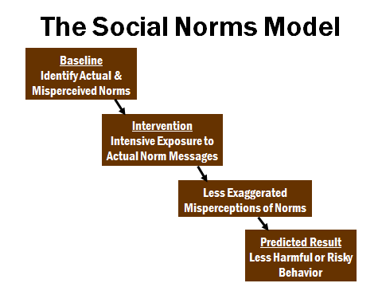
Social Norms Approach to Prevention

Slide 3
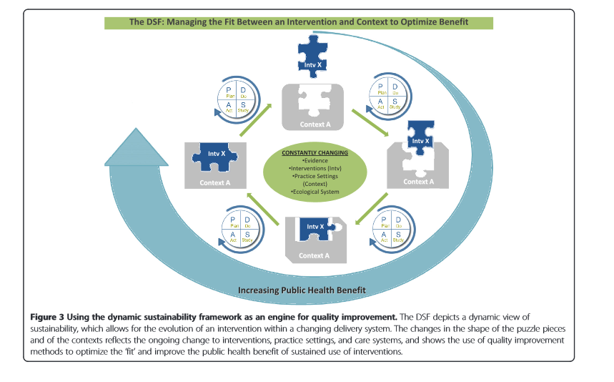
Chambers, Glasgow, & Stange, 2014 – Implementation Science

Slide 4
Phase II Social Norms: 2015-2017
Phase II tested a sustainable implementation process;
Administering only one pretest data collection to establish baseline norms;
Evaluating three media campaign methods - based upon data collection and response rates (base-specific, aggregate, or AF generic);
Addressing the challenges and successes of implementation; and
Conducting statistical analyses of the impact of the intervention using ARM rates.

Slide 5
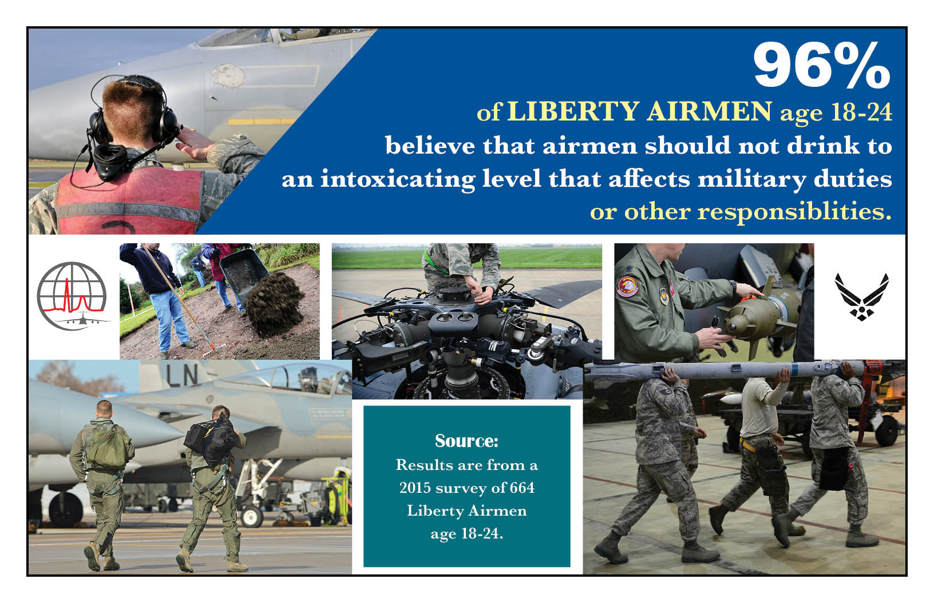
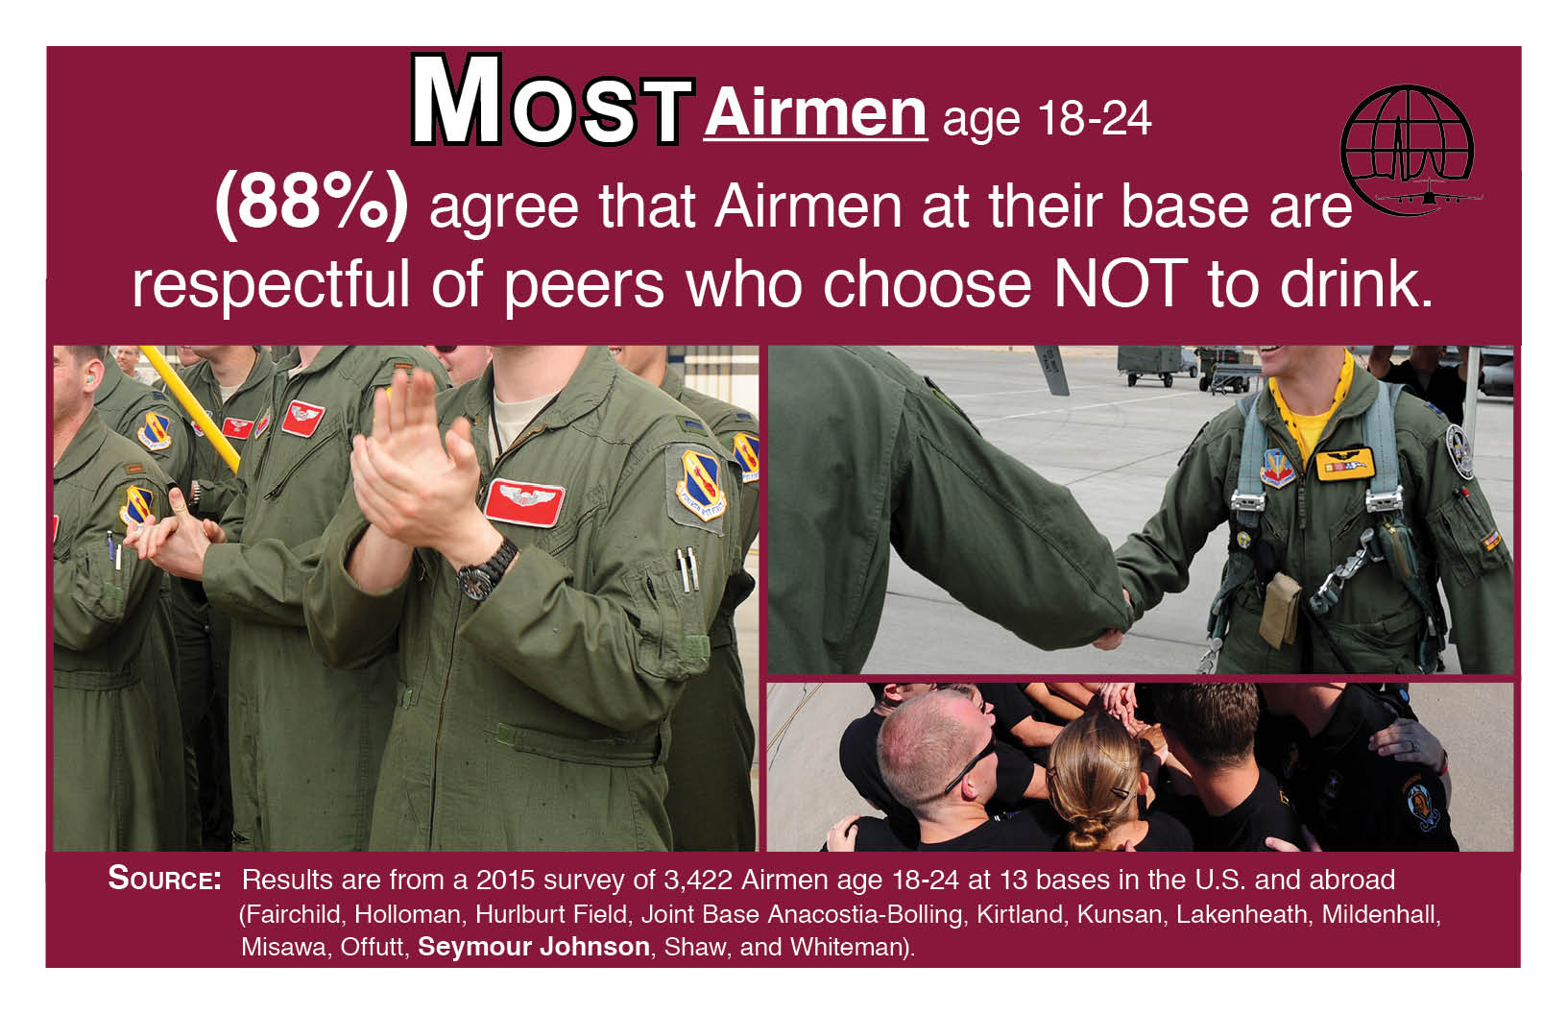
Base-Specific & Aggregate Media Examples
Six bases (43%) achieved a 40% response rate or higher
Eight bases (57%) did not achieve the 40% target response rate

Slide 6
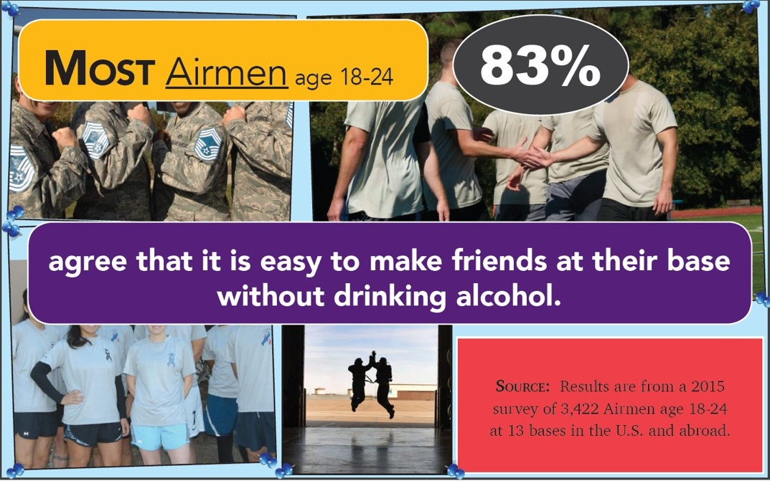
Generic Media Example

Slide 7
Phase II Target Outcomes
The total ARMs, the total drinking ARMs, and the total DUI/DWI counts were analyzed separately:
  Examined different levels and/or different rates of change at post-intervention; and
  Adjustments were necessary for these three outcomes before implementing statistical models (e.g., adjustments for rate per 1,000 Service members, adjustments for outliers, log transformation to normalize distributions).
Total ARMs | Drinking ARMs
DUI/DWI | ✓
Accidental Injury
Domestic violence
Other crimes against property
Drunk disorderly | ✓
Duty-related incident
Contribute to delinquency
Crimes against property
Public intoxication | ✓
Open container | ✓
Underage drinking | ✓
Notes:
ARMs= Alcohol Related Misconducted

Slide 8
Analysis and Results
Analysis of Each Treatment Group
  Separate analyses of intervention impact for each of the 3 trt groups.
  Models compared intervention bases for each treatment with the corresponding set of matched comparison bases.
  Results for models for the three ARMs’ outcomes indicated no patterns of statistical differences other than isolated cases that would be attributable to chance.
Analysis of Change Within SN Bases
  MLM with a discontinuity regression structure examined within-base change among those bases that received the intervention.
  Results indicated no change in the three outcomes across the 12-month period post-intervention relative to the 12-month period pre-intervention.
Notes:
MLM
This approach compared the social norms bases to themselves and examined differences in ARM outcomes pre- and post-intervention; no comparison bases were included in these statistical models.

Slide 9
Helpful Readings
Chapters 7 & 8 of the National Academies of Sciences, Engineering, and Medicine (2019). Strengthening the military family readiness system for a changing American Society. The National Academies Press. https/doi.org/10.17226/25380
Chambers, D.A., Glasgow, R.E. & Stange, K.C. The dynamic sustainability framework: addressing the paradox of sustainment amid ongoing change. Implementation Sci 8, 117 (2013). https://doi.org/10.1186/1748-5908-8-117
Chambers, D. A., and Norton, W. E. (2016). The adaptome: Advancing the science of intervention adaptation. American Journal of Preventive Medicine 51(4), S124-S131.
Glasgow, R. E., and Chambers, D. (2012). Developing robust, sustainable, implementation systems using rigorous, rapid and relevant science. Clinical and Translational Science, 5(1), 48-55.
Curran, G. M. (2020) Implementation science made too simple: a teaching tool. Implementation Science Communication. https://doi.org/10.1186/s43058-020-00001-z
Proctor E, Silmere H, Raghavan R, Hovmand P, Aarons G, Bunger A, Griffey R, Hensley M. Outcomes for implementation research: conceptual distinctions measurement challenges, and research agenda. Adm Policy Ment Health.2011;38(2):65–76.

