Slide 1
Applying Implementation Science to School-Based Prevention
SSRI-CTSI Implementation Science Workshop
Jennifer L. Frank, PhD
December 18, 2020

Slide 2
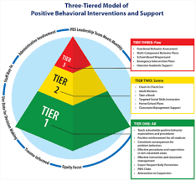




Overview of Programs & Projects
Systems-Focused
Teacher-Focused
Student-Focused
Positive Behavioral Interventions and Supports (PBIS)
Cultivating Awareness & Resilience in Education
IES: Goal 2 & 3
Project RESPECT
IES Goal 2
Learning to Breathe
IES Goal 2
Transformative Life Skills
GBY Foundation
IES Goal 2 & 3
Notes:
Contemplative Practices: structured activities that “require individuals to exercise volitional control over their physical and mental activity” (Davidson & Mind and Life Education Research (MLERN) Network, 2012).

Slide 3

Applications of Implementation Science Research
(Bernet et al., 2013)
Type 1
  Mixed-Methods Examine Feasibility, Acceptability, and Assumptions Regarding Change Processes
Type 2
  Creation & Validation of Implementation Measures
  Validation of Cut-Points & Thresholds for Implementation Monitoring & Decision-Making
  Development of Supplemental Components to Address Implementation Challenges
Type 3
  Formal Testing of Components/Processes to Address Implementation Challenges

Slide 4
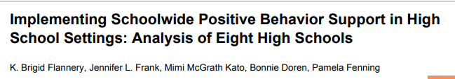

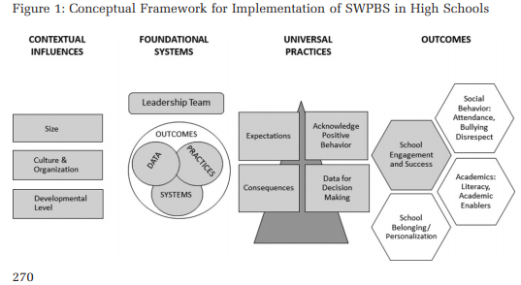
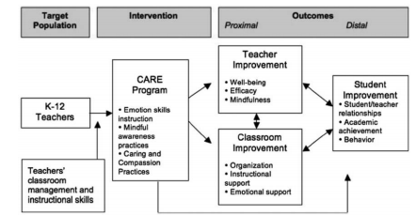
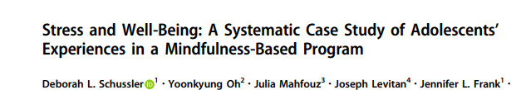
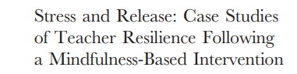
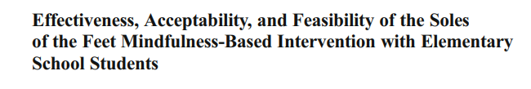
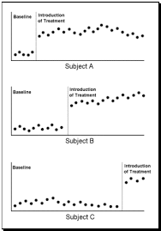
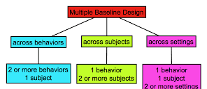
Type 1 Design Activities
Test of Clinical Intervention + Secondary Data to Inform Subsequent Trials
Feasibility & Acceptability of Implementation Via Mixed Methods
    Qualitative Protocol Mapped to Intervention Theory of Action
    Qualitative Systematic Case Studies of Responder and Non-Responder Cases
    Single Case Designs to Examine Stability, Immediacy, and Magnitude of Effect Across
          Participant Groups
          Behaviors of Interest
          Settings of Intended Generalization

Slide 5
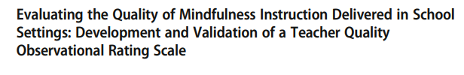
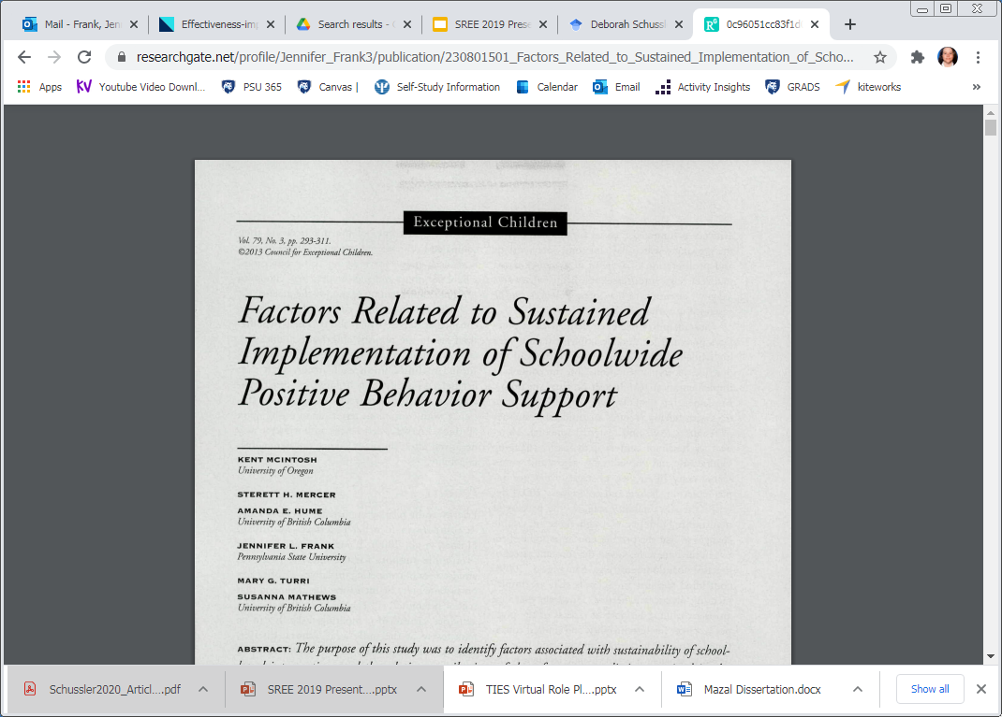


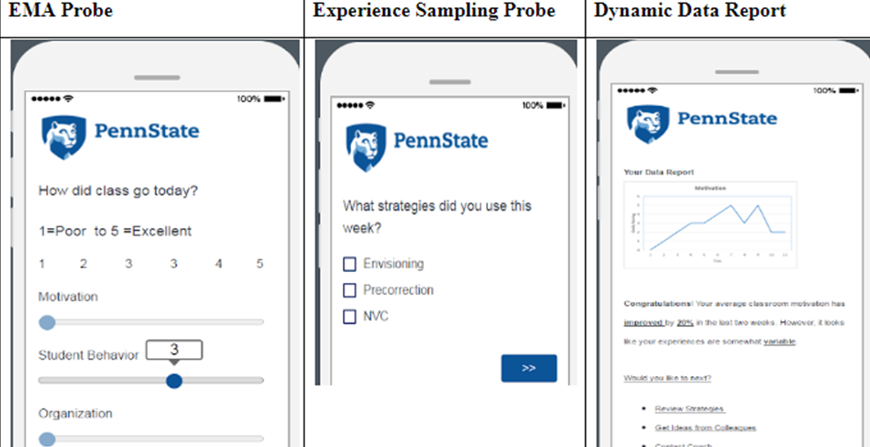
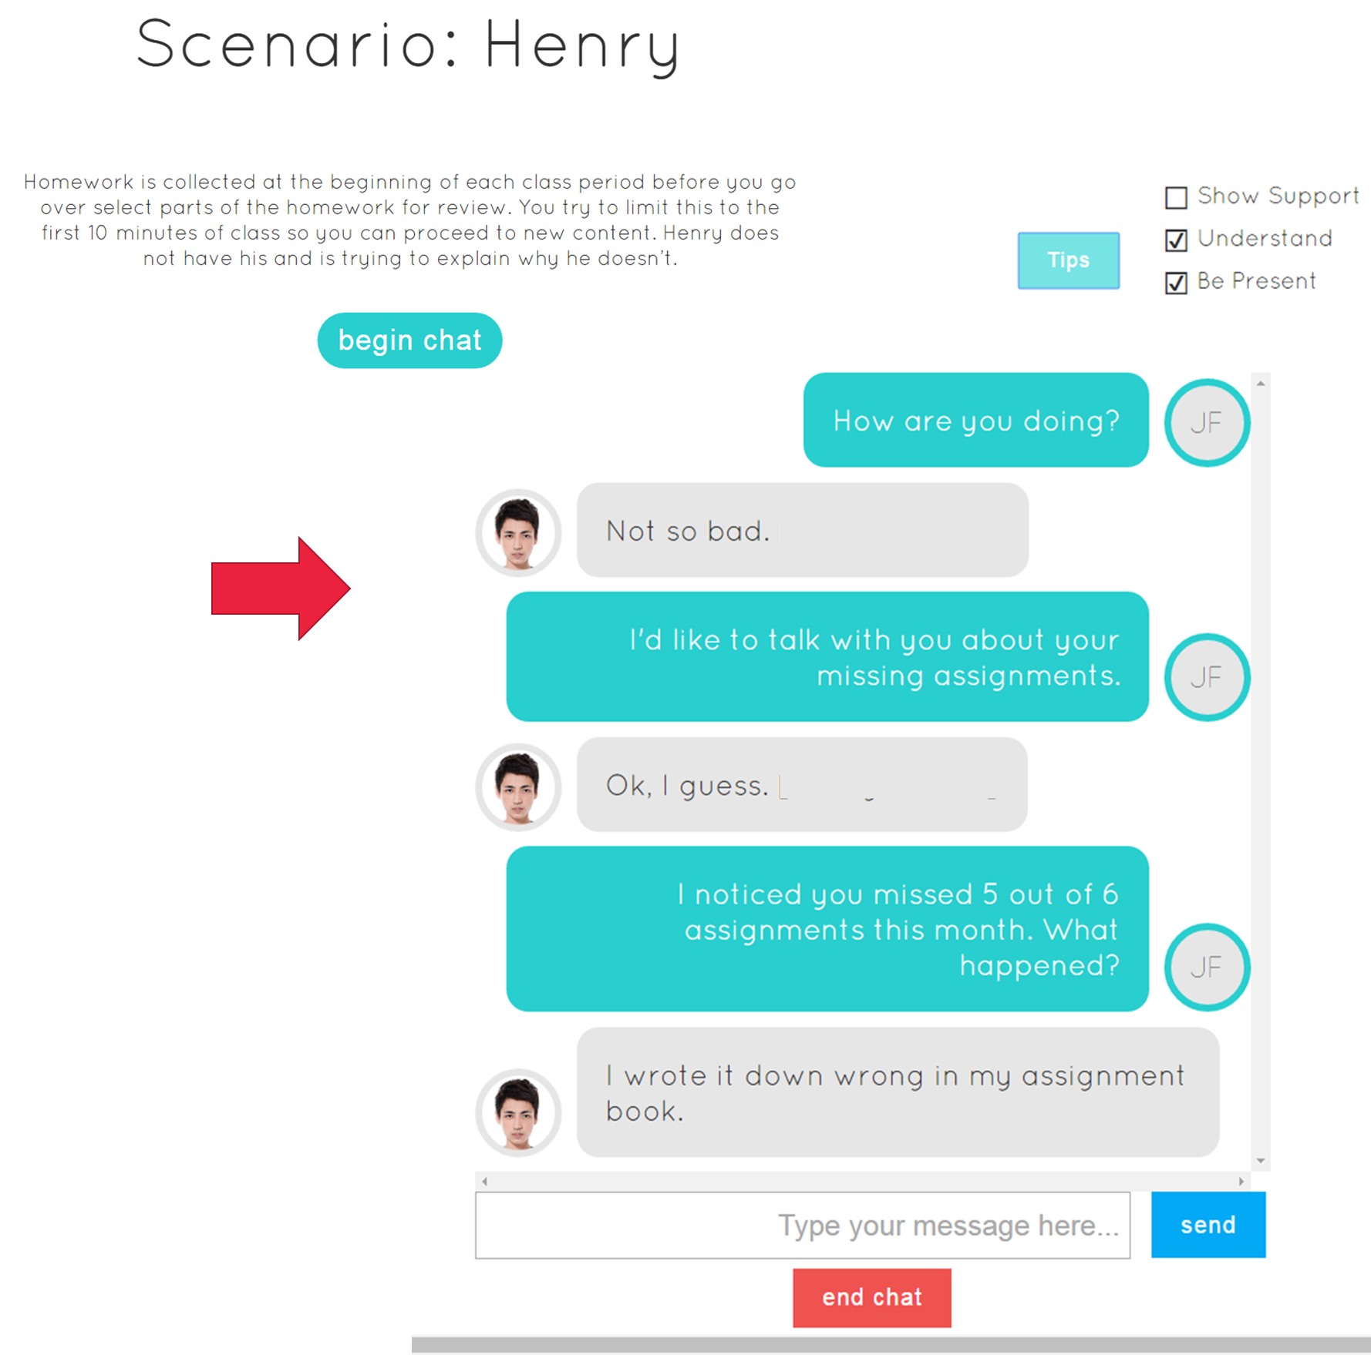

Type 2 Design Activities
Test of Clinical Intervention + Test of Implementation Strategy
Creation & Validation of Implementation Measures
    Observational Protocols
    Multi-Method Implementation Measures (Ratings + Products)
    Validation of Context-Specific Cut-Points & Thresholds for Implementation Monitoring Using Local Data Sources
Development and Piloting of Components to Address Implementation Challenges
    Coaching & Feedback: Virtual Coaching
    Sustained Practice: Virtual Role Play
    Supplemental Content (Self-Care)

Slide 6


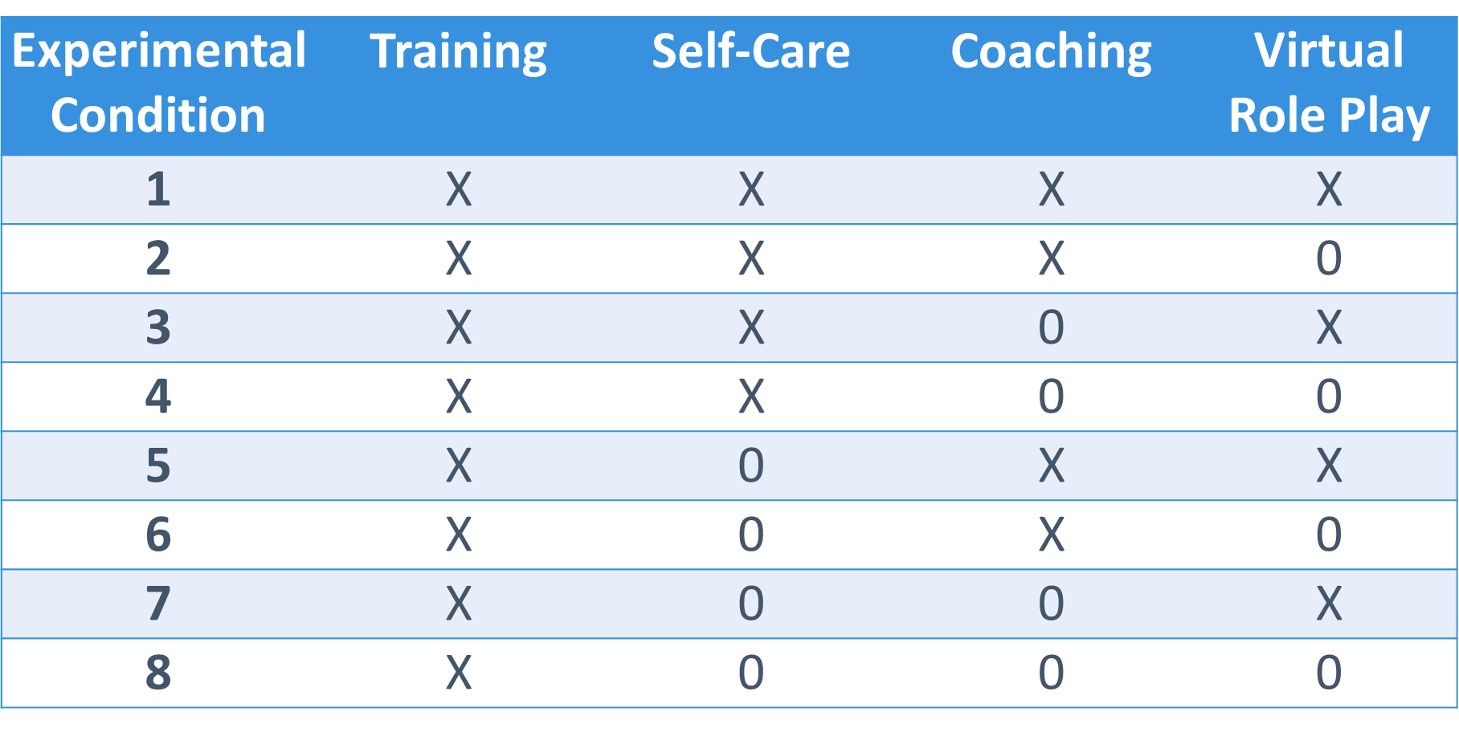
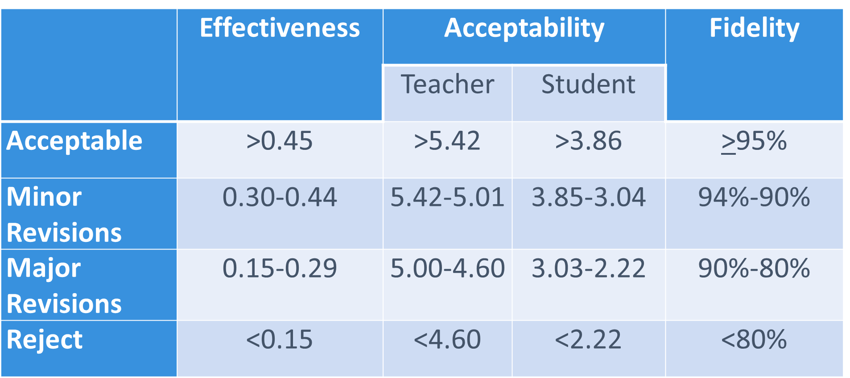
Type 3 Design Activities
Test of Implementation Strategy
Testing of Components to Address Implementation Challenges
Fractional Factorial Designs to Explore “Dosage”
Anchored Revisions to Benchmarks for Effectiveness, Acceptability, and Fidelity/Sustainability
Findings Inform Implementation Decisions
          Coaching: Reactivity and Classroom Management
          Virtual Role Play: Implementation of Intervention Strategies
          Self-Care: Teacher Burn-Out, Maladaptive Verbal & Non-Verbal Behavior

