Slide 1
Understanding the process of bridging research and policy
Max Crowley PhD & Taylor Scott PhD

Slide 2
Policymaking is Central to Implementation Science
Implementation science seeks to bridge the gap not only to practice, but the policy community
Tremendous role in whether scientific evidence and innovation are use (or not)
Use of research by policymakers can not only be studied, but also improved
One model is the Research-to-Policy Collaboration
Crowley, M. Supplee, L., Scott, T., & Brooks-Gunn, J. (2019) The Role of Psychology in Evidence-based Policymaking: Mapping Opportunities for Strategic Investment in Poverty Reduction. American Psychologist. Scott, T., Larson, J., Buckingham, S., Maton, K., & Crowley, M. (2019) Bridging the research-policy divide: Pathways to engagement and skill development. American Journal of Orthopsychiatry, 89(4), 434-441.

Slide 3
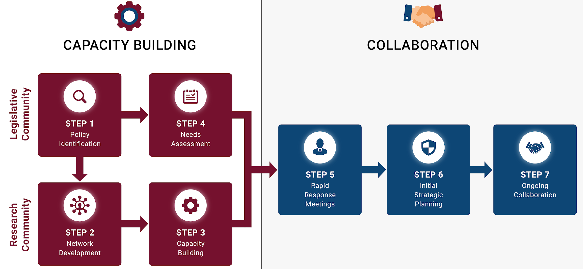
We Can Create Formal Policy Implementation Supports
Crowley, M., Scott, T.,* & Fishbein, D. (2018). Translating prevention research for evidence-based policymaking: Results from the research-to-policy collaboration pilot. Prevention Science, 19(2) 260-270. PMC5803346
Notes:
We start with a needs assessment to understand what policymakers priorities are (step 1) and their short-term goals (step 4). We also build capacity at the same time to identify researchers with relevant experiences (step 2) and support their policy skill development (step 3).
Identifying policy priorities and researchers with related experiences allows us to then match these parties so that they meet (step 5) and plan out ways to work together (step 6) in ongoing collaboration (step 7)

Slide 4
We Can Experiment in Implementation Science
Congressional Offices
Researchers
Crowley, D. Max, Scott, J. T., Long, E., Green, L., Israel, A., Supplee, L., Jordan, E., Oliver, K., Guillot-Wright, S., Gay, B., Storace, R., Torres-Mackie, N., Murphy, Y., Donnay, S., Reardanz, J., Smith, R., McGuire, K., Baker, E., Antonopoulos, A., … Giray, C.. (in press) Lawmakers Use of Scientific Evidence Can Be Improved: Randomized Controlled Trial of the 116th US Congress. Proceedings of the National Academy of Sciences.

Slide 5
We Can Improve Policymakers Use of Research evidence
Congressional Value
For Research Evidence
Introduction of Legislation
Using Research Evidence
Researchers Knowledge of
Engaging with Policymakers
Crowley, D. Max, Scott, J. T., Long, E., Green, L., Israel, A., Supplee, L., Jordan, E., Oliver, K., Guillot-Wright, S., Gay, B., Storace, R., Torres-Mackie, N., Murphy, Y., Donnay, S., Reardanz, J., Smith, R., McGuire, K., Baker, E., Antonopoulos, A., … Giray, C.. (in press) Lawmakers Use of Scientific Evidence Can Be Improved: Randomized Controlled Trial of the 116th US Congress. Proceedings of the National Academy of Sciences.

Slide 6
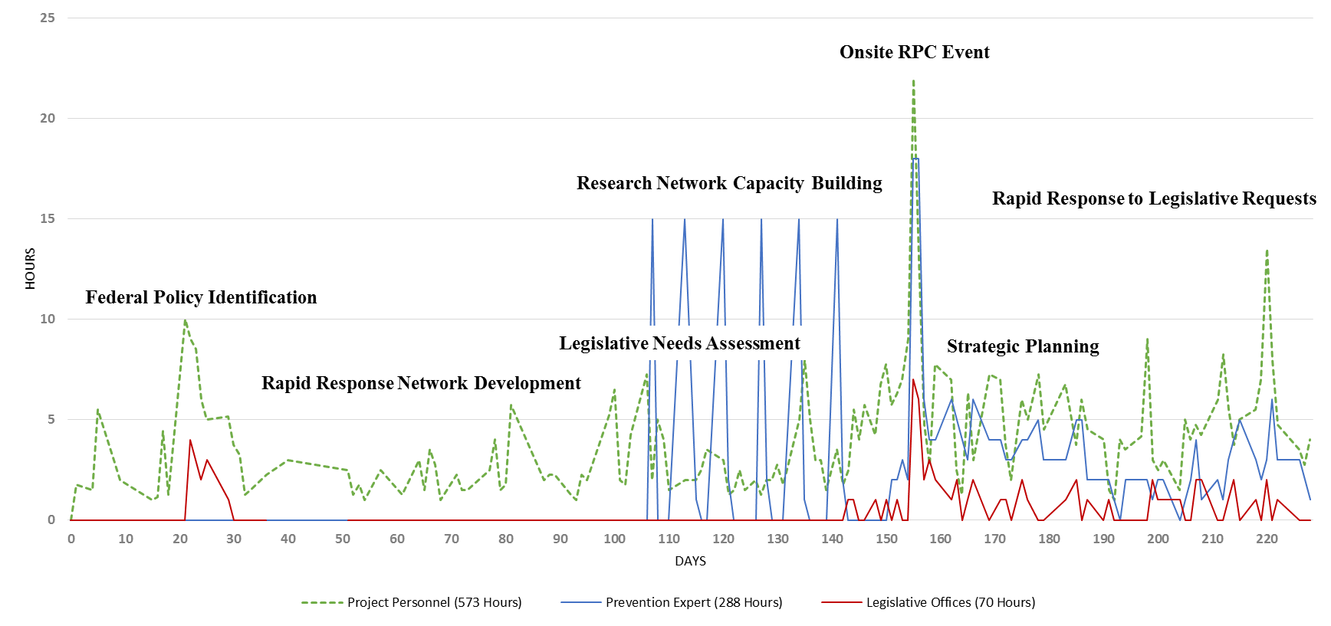
We Can Study the Cost of Improving Research Use in Policy
Crowley, M., Scott, T.,* & Fishbein, D. (2018). Translating prevention research for evidence-based policymaking: Results from the research-to-policy collaboration pilot. Prevention Science, 19(2) 260-270. PMC5803346

Slide 7
Thank YOu

