Slide 1
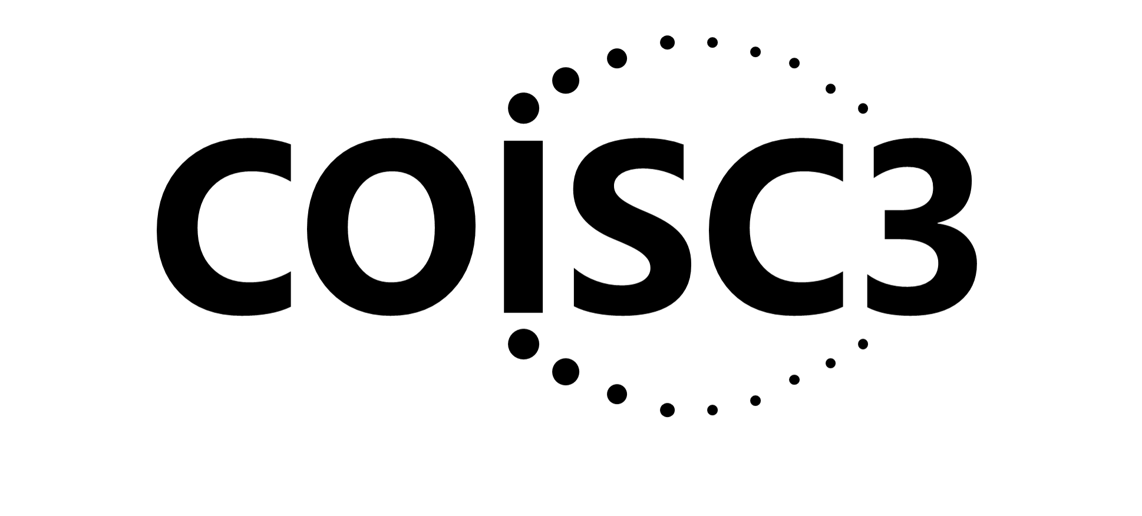

The What, Why, Where and How of Implementation Science: Applying the RE-AIM Framework
Russell E. Glasgow, PhD
University of Colorado School of Medicine and
Eastern Colorado VHA QUERI and GRECC programs
Presented at Penn State University December 18, 2020
Acknowledgments
Ross Brownson, David Chambers, Amy Kilbourne, Borsika Rabin and the other great researchers cited throughout this talk

Slide 2
Objectives
Describe the rationale for and key characteristics of implementation science (IS)
As an example, discuss the RE-AIM framework and its application
Overview some key concepts and evaluation issues in IS:
  Understanding Context
  Adaptations
    Complex Implementation Outcomes
Planning IS research- key issues in applying the above to your research

Slide 3
Need for IS Research
Traditional biomedical RCTs study treatments delivered to carefully selected populations under ideal conditions
Even when we do implement a tested intervention into everyday practice, we often see a “voltage drop”…a dramatic decrease in effectiveness
Most common reason evidence- based programs, policies, practices and products are not adopted is they are not seen as relevant
“If we want more evidence-based practice, we need more practice-based evidence.”
Green LW
Am J Pub Health 2006
Rothwell PM. External validity of randomised controlled trials. Lancet 2005;365:82-93.
Notes:
Use intervention...program- policy, product,

Slide 4

Too often, we have assumed, “If you build it…”

Slide 5
Implementing An Evidence-Based Product (or Obesity Tx Program; or COVID-19 Vaccine) Story
Even if 100% effective...is only so good as how and whether:
It is adopted widely, including in low resource settings
Local stakeholders and delivery staff choose to deliver it
It can be delivered consistently with quality
Intended recipients, including those at highest risk receive it
It can be sustained
If we assume 70% success for each step above…
Impact: .7x .7x .7x .7 x .7 = 17% benefit to society
Glasgow RE, Vogt TM, Boles SM. Am J Public Health. 1999;89(9):1322. www.re-aim.org
Glasgow RE, et al. Frontiers Public Health 2019 7:64. doi: 10.3389/fpubh.2019.00064

Slide 6
Conclusions?
What is the moral of this story?
Each step in the process is important
Research needs to devote attention to all steps- in the research to impact process, not just effectiveness

Slide 7
Key Terms
Implementation science is the study of methods to promote the integration of research findings and evidence into healthcare policy and practice.
Dissemination research is the scientific study of targeted distribution of information and intervention materials to a specific public health or clinical practice audience. The intent is to understand how best to spread and sustain knowledge and the associated evidence-based interventions.
Implementation research is the scientific study of the use of strategies to adopt and integrate evidence-based health interventions into clinical and community settings to improve patient outcomes and benefit population health.
Pragmatic research is the use of real-world tests in real-world populations and situations.
Brownson, Colditz & Proctor. Dissemination and Implementation Research in Health. 2018

Slide 8
Key Characteristics of IS Science
Point # Characteristic Implication
Systems Perspective
1 | Context is critical | Research should focus on and describe context
2 | Multilevel complexity | Most problems and thus, effective interventions are multilevel and complex
3 | Focus on systems characteristics | More emphasis needed on interrelationships among system elements and systems rules
Robust, Practical Goals
4 | Representatives and reach | Focus on reaching broader segments of population and those most in need
5 | Generalizability | Study generalization (or lack of such) across settings, subgroups, staff, and conditions
6 | Pragmatic and practical | Producing answers to specific questions relevant to stakeholders
7 | Scalability and sustainability | From outset, greater focus on scale-up potential and likelihood of sustainability
Glasgow RE, Chambers D. Developing robust, sustainable, implementation systems using rigorous, rapid and relevant science. Clin Transl Sci. 2012;5(1):48

Slide 9
Key Characteristics of IS Science (cont.)
Point # Characteristic Implication
Research Methods to Enhance Relevance
8 | Rigorous | Identify and address plausible threats to validity in context of questions. Greater focus on replication.
9 | Rapid | Approaches that produce faster answers
10 | Adaptive | Best solutions usually evolve over time, as a result of informed hypotheses and mini-tests with feedback
11 | Integration of methods; triangulation | For greater understanding, integrated Quantitative and Qualitative methods are often required
12 | Relevance | Relevance to stakeholders should be top priority
Flexibility
13 | Multiplicity | Encourage and support diverse approaches with the above characteristics (all models are wrong)
14 | Respect for diverse approaches; humility | Different perspectives, goals, methods and approaches are needed. Continuing the same existing approaches will produce the same unsatisfactory results.

Slide 10
Comparison of IS vs. Effectiveness Research
Characteristics of Outcomes and Measures | D&I Outcomes and Measures | Standard Effectiveness Outcomes and Measures-what is used in YOUR field?
Focus | Delivery and implementation issues (aka process: feasibility, fidelity, adoption, reach) | Ultimate outcome or end result (only)
Breadth | Multiple levels and outcomes, broad focus, systems perspective | Narrower focus; often a single primary outcome
Preferred Evaluation Modality | Multiple- observation, interview, tracking forms | Single method; more recently data in the EHR
Expense And Intensiveness Of Assessment | Brief, low burden, pragmatic | Often expensive, requires expert assessment; emphasis on blinding when possible
Level And WHO Is Assessed | Setting, staff and end users | Usually end recipients such as customers, students, patients

Slide 11
Types of Outcomes in Implementation Research- focus on setting and staff delivery
Implementation Outcomes | Intermediate Outcomes | Ultimate Outcomes
Acceptability | Efficiency | Population health
Adoption | Effectiveness | Clean air
Appropriateness | Equity | Reduced opioid deaths
Costs | Client or customer-centeredness | Reduced inequities
Feasibility | Timeliness | Fewer traffic fatalities
Penetration | Safety | Decreased early mortality
Sustainability
Proctor E, Silmere H, Hensley M, et al. Outcomes for implementation research: Administration and policy in mental health. 2011;38(2):65-76.
Notes:
Bryan can you make ‘lines go away’

Slide 12
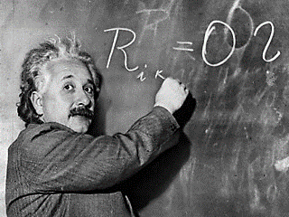
“The significant problems we face cannot be solved by the same level of thinking that created them.”
Albert Einstein

Slide 13
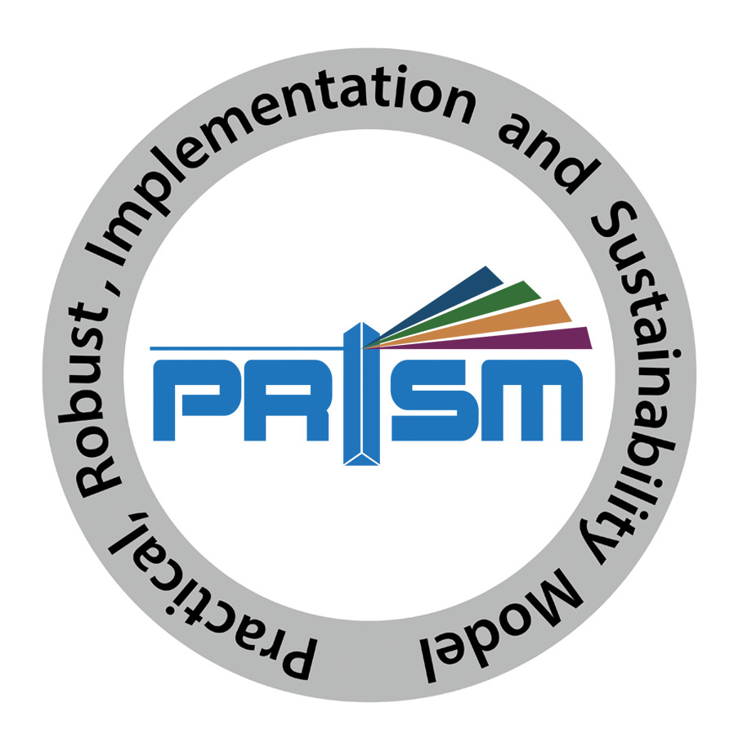
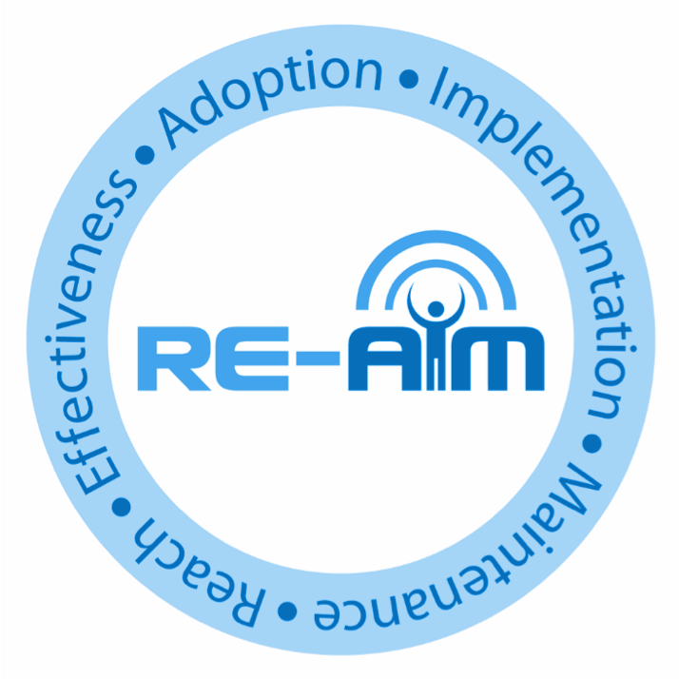
Example Models: RE-AIM and
PRISM = RE-AIM in Context
*PRISM logo in development
www.re-aim.org

Slide 14

Purpose and History of RE-AIM Framework
Intended to facilitate translation of research to practice, policy and real world application
Balance internal and external validity, and emphasizes representativeness and equity
Individual (RE) and Multi-level Setting (AIM) factors- community, organization, staff
Ultimate Impact depends on all elements (reach x effectiveness, etc.)
www.re-aim.org
Glasgow RE et al. RE-AIM at 20. Frontiers Public Health. 2019: 7: 64
Glasgow et al. Amer J Public Health. 1999; 89: 1322-1327

Slide 15
Pragmatic Use of RE-AIM- What is Feasible?
RE-AIM Dimension | Key Pragmatic Priorities to Consider and Answer
Reach | WHO is (was) intended to benefit and who actually participates or is exposed to the ‘program’ or policy?
Effectiveness | WHAT is (was) the most important benefit you are trying to achieve and what is (was) the likelihood of negative outcomes?
Adoption | WHERE is (was) the program or policy applied WHO applied it?
Implementation | HOW consistently is (was) the program or policy delivered? HOW will (was) it be adapted? HOW much will (did) it cost? WHY will (did) the results come about?
Maintenance | WHEN will (was) the program become operational; how long will (was) it be sustained (setting level); and how long are the results sustained (individual level)?
Glasgow RE & Estabrooks, P. Preventing Chronic Disease, 2018; 15: E02
Notes:
Program, policy, product. Intervention, innovation, assessment

Slide 16
RE-AIM—Health Equity Implications
RE-AIM Issue | Disparity | Overall Impact
Reach | 30% | 70% benefit
Effectiveness | 0 (equal) | 70% benefit
Adoption | 30% | 49% benefit
Implementation | 30% | 34% benefit
Maintenance | 30% | 24% benefit
Take Home Message: Equity issues at EACH STAGE of RE-AIM process
Notes:
This slide uses hypothetical data to illustrate the importance of broad thinking about outcomes. The importance of focusing on all five dimensions of RE-AIM – effectiveness is not the only important factor, especially in disparities. Note if one only focused on effectiveness, one would likely conclude there were no health disparities associated with this program or policy

Slide 17
ADOPTION
# and type of settings that participate
Tailor to and engage leaders, stakeholders and address history
RE-AIM Outcomes
Cascade
Make implementation simple, low cost and burden, and provide support
IMPLEMENTATION
Consistently deliver intervention and resources with quality
Multiple and diverse tailored promotion channels and increased access
REACH
(equity)
# and type of citizens and families that participate
Utilize evidence-based resources and strategies; make data-based adaptations
RE-AIM steps in cascade
EFFECTIVENESS
(equity)
# and type of citizen and families that benefit
(on what outcomes)
Provide ongoing feedback, support and resources for implementation
Gaps or steps where impact is lost
MAINTENANCE
Long-term implementation and effectiveness
Potential ways to minimize drop-off

Slide 18
My Own Heath Report (MOHR)
Application of RE-AIM to planning and evaluation of an interactive, web-based health risk appraisal and feedback system
Cluster randomized trial of 18 diverse primary care practices across the U.S. and 3,591 patients (28% Latinx, 51% high school education or less)
Primary outcomes were reach, adoption and implementation
Glasgow, et al. (2014). Conducting rapid, relevant, research. Am J Prev Med, August;47(2):212-9.
Krist, et al. (2016). The impact of behavioral and mental health risk assessments. Transl Beh Med Jun; 6(2):212-9.

Slide 19
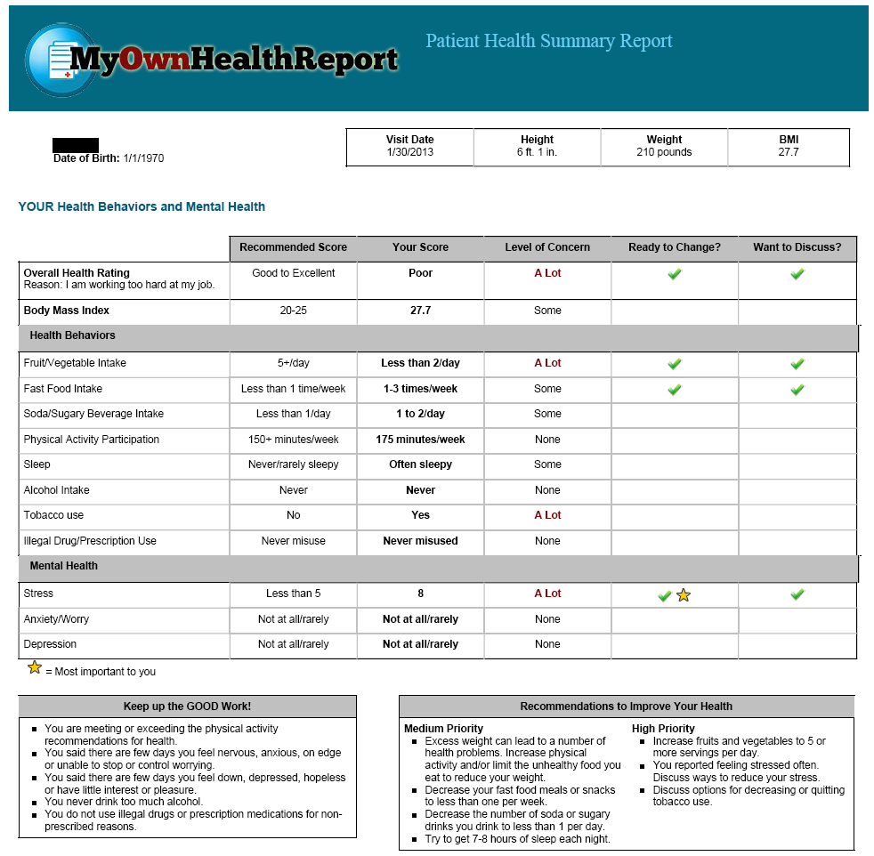
Basic patient and clinician goal advice
(electronic) and goal-setting (paper)
Assessment and feedback content is standard
How these are implemented is adapted

Slide 20
Example of Planning for Context, Equity and Adaptations using RE-AIM in the MOHR Study
Reach*: Options for clinics and patients in contact modalities (phone, e-mail, EHR, waiting room); in context of regular visits- remove barriers
Effectiveness: Shared Decision Making on goals, among 11 potential behavioral risk factors (most patients had 4 or more)
Adoption*: Fit with reimbursement for annual wellness exams; CME; few resources required, largely automated, in English and Spanish
Implementation*: Options of where and when the BRIEF online session, real time feedback, and related counseling/goal setting occur and who does this
Maintenance: Not well done- assumed reimbursement would be sufficient; needed to be integrated into the EHR
Notes:
BRYAAN- can you get to fit??
BF - Looks like it fits to me….anything specifically?

Slide 21
Adoption
18 of 30 Practices invited agreed to adopt MOHR (Adoption = 60%)
Decliners were doing other studies, worried about workload, or doing HRAs
Participating practices represented a diverse spectrum of primary care

Slide 22
Overall Reach: 1768 of 3591 patients (49.2%)
Reach of Different Approaches
Mailed (patient completed)
4 sites | average 30%
Phone (nurse completed)
1 site | 64%
Lobby (patient + staff completed)
1 site | 44%
Lobby (MA or coordinator completed)
4 sites | average 75%

Slide 23
Implementation and adaptations (content of computerized system was standardized)
  Assessment strategies:
  Web at home
  Patients completed by self in waiting room
  Research team or some health systems assistance
  Counseling:
  Physicians
  Other staff-nurse, behavioral health
  No additional counseling
  Cost: Delivery of MOHR took 28 minutes (range 16-31), including assessment, feedback and counseling

Slide 24
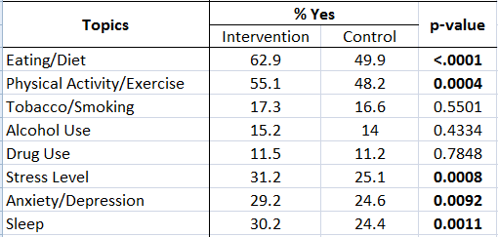
Effectiveness: Secondary Outcome
Have you made any positive changes?

Slide 25
Moral of this Example?
Success demands tailoring, customization and adaptation at the levels of:
    individual (patient)
    staff or implementation personnel (clinician)
    setting- (often multi-level: primary care practice here)

Slide 26
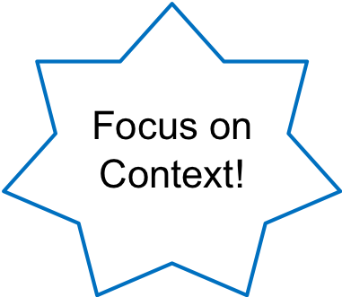
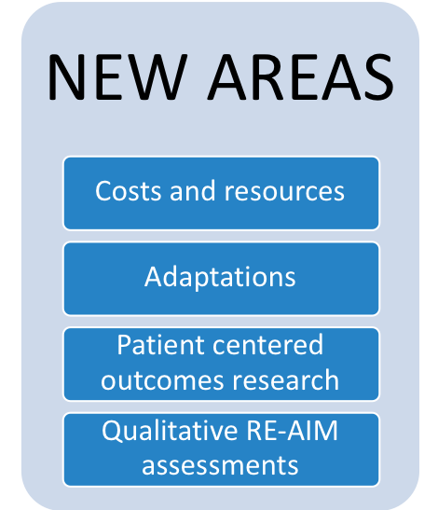
Evolution of RE-AIM
Applied to many different content areas
Used for both planning and evaluation
Underreporting of key components:
  Setting level factors reported much less often (e.g., adoption, maintenance)
Gaglio, et al. The RE-AIM framework….AJPH 2013; 103:38-46.
Holtrop, et al. BMC Health Serv Res. 2018 Mar 13;18(1):177. doi: 10.

Slide 27
Context Issues from a RE-AIM Perspective
People exist in the context of culture and places in which they work, live, study and play
Context is multi-level and dynamic - not just places, but also history and relationships (trust, etc.) (Take Home Message)
Studying and understanding context is challenging:
  So many factors…which are most important for which issues, for which settings, for which populations
  Need for brief, validated pragmatic measure
Bayliss et al. Understanding context. Ann Fam Med (2014) 12: 260-269
Chambers, D et al. The dynamic sustainability framework.

Slide 28
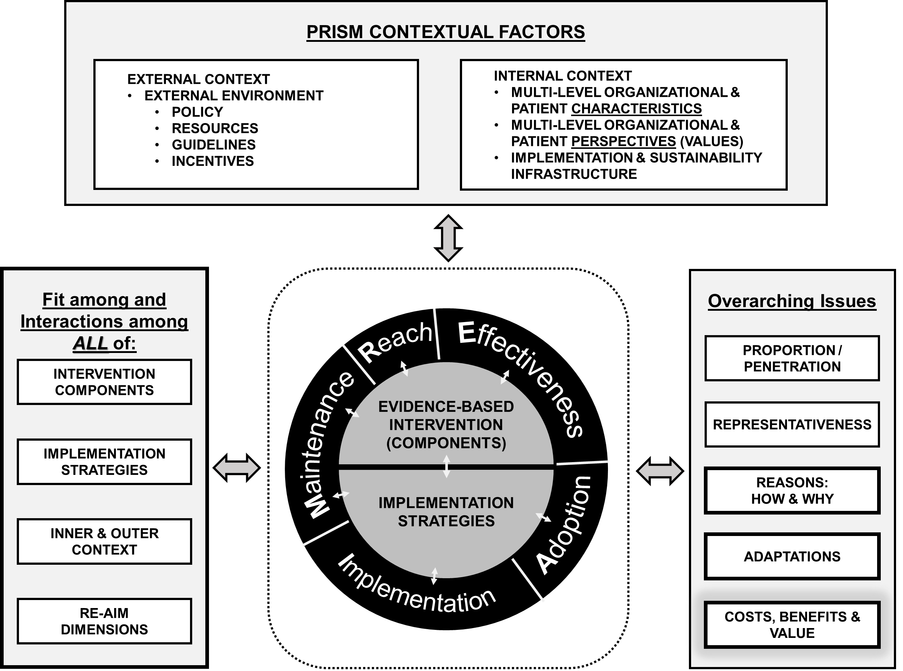
CONTEXT- assessed via “PRISM” in Expanded RE-AIM/ PRISM
See www.re-aim.org for figure
PRISM = Pragmatic Robust Implementation and Sustainability Model
Feldstein & Glasgow (2008). Joint Commission J on Qual. & Patient Safety, 34: 228-43.

Slide 29
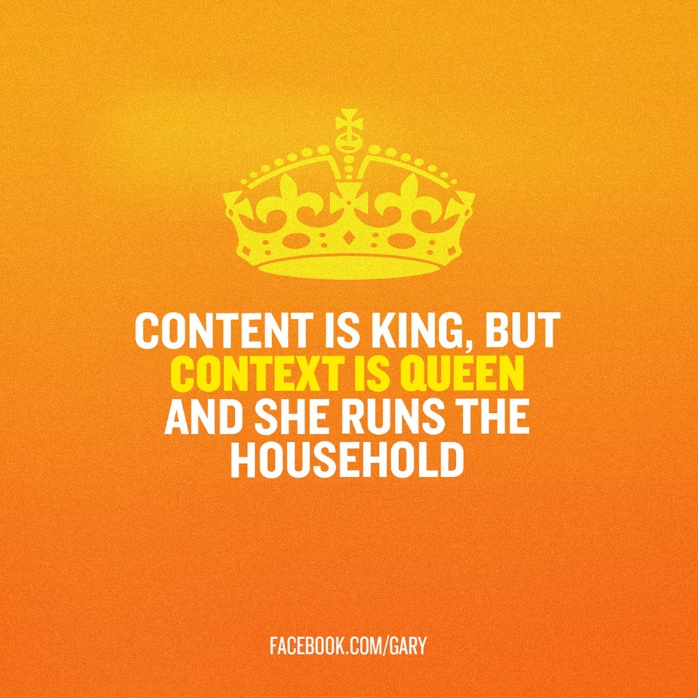

Slide 30
RE-AIM Summary Points
RE-AIM is not a theory, but it tells you where to look; where things often break down- (remember the ‘Cascade’ slide)
RE-AIM is an outcomes framework that can be used for planning and evaluation....and iteratively
Each dimension is an opportunity for intervention
RE-AIM can be used for basic and applied, observational, efficacy, and implementation science projects
www.re-aim.org

Slide 31
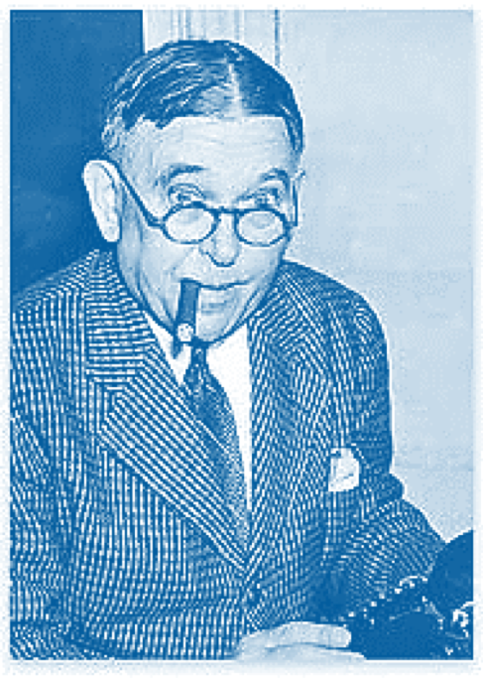
All Models (and Methods) Are Wrong…Some Are Useful
“To every complex question,
there is a simple answer…
and it is wrong.”
~H. L. Mencken

Slide 32

Take Home Message: Adaptations Happen (and are not bad)
Evaluating complex interventions: Confronting and guiding
(vs. ignoring and suppressing) heterogeneity and adaptation
Brian S. Mittman, PhD Oct. 2018
Department of Research and Evaluation, Kaiser Permanente Southern California

Slide 33

Traditional View of Fidelity and Adaptation:
‘Tug of War’
Internal Validity
External Validity
Fidelity
Adaptation
Notes:
BORSIKA
differing approaches for developing and testing programs in a research study (e.g., an efficacy trial) and subsequent dissemination of effective programs in real-world contexts
Research studies emphasize internal over external validity and typically have more resources than what are generally available when programs are disseminated into varied and complex real-world settings (Glasgow et al., 2003). Focusing on internal validity may minimize the importance of real-world factors on implementation such as local context; the roles of local stakeholders in planning, implementation, and evaluation; and the interaction between programs and the contexts in which they are implemented (Glasgow et al., 2003; Hawe, Shiell, & Riley, 2009; Oakley, Strange, Bonell, Allen, & Stephenson, 2006). These factors have implications for the role of outcome and process evaluation (Hawe, Shiell, & Riley, 2004; Hawe et al., 2009; Oakley et al., 2006), and in the planning process throughout the program life cycle, so they are relevant for developing flexible and adaptive interventions.
Focusing on internal validity may minimize the importance of real-world factors on implementation such as local context; the roles of local stakeholders in planning, implementation, and evaluation; and the interaction between programs and the contexts in which they are implemented (Glasgow et al., 2003; Hawe, Shiell, & Riley, 2009; Oakley, Strange, Bonell, Allen, & Stephenson, 2006). These factors have implications for the role of outcome and process evaluation (Hawe, Shiell, & Riley, 2004; Hawe et al., 2009; Oakley et al., 2006), and in the planning process throughout the program life cycle, so they are relevant for developing flexible and adaptive interventions.

Slide 34
Form vs. Function
Core Functions and Forms of Complex Health Interventions: Perez Jolle et al J Gen Intern Med 34(6):1032–8

Slide 35
Types of Adaptations – Cultural; Resources; AND Local: ALL WITH AND DRIVEN BY STAKEHOLDERS
Focus of Adaptation | Timing of Adaptation (point in the project)
 | Planning | During | Sustainment- Dissemination
Intervention
Implementation Strategy
Setting

Slide 36
Steps in Designing Impactful IS Research
Specify the ‘gap’ between need and current situation; and the Evidence Based Program (EBP) you are using or considering
Engage multiple types of stakeholders- on an ongoing basis
Complete a ‘Logic Model’ –of Starting Conditions; Inputs (EBP and possible implementation strategies); and Outcomes
Decide on your theory, conceptual model or framework
Design evaluation (with stakeholders) and use implementation strategies that FIT your context (1)
Decide on Outcomes and Pragmatic Evaluation Measures (2)
Prepare for iteration and adaptions (Your 1st plan never works)
1. Proctor EK, Powell BJ, McMillen JC. Implementation strategies. Implement Sci. 2013;8:139.
2. Stanick et al Translational Behavioral Medicine, ibz164, https://doi.org/10.1093/tbm/ibz164

Slide 37
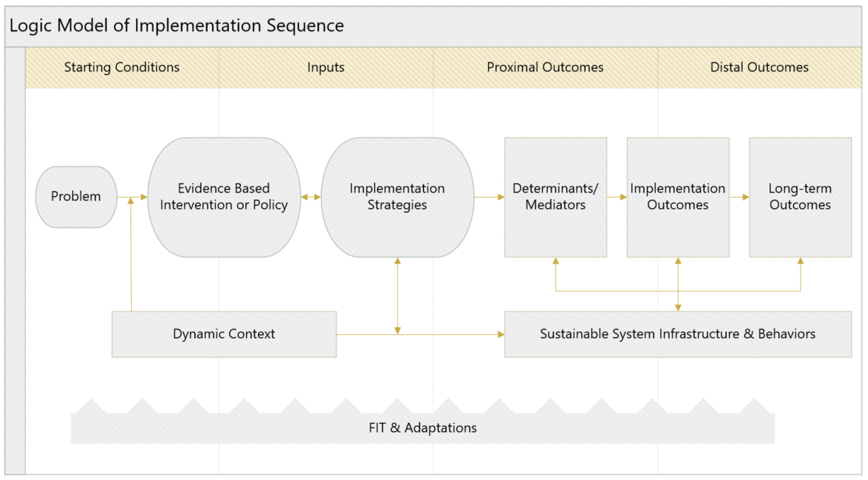
Start with a Logic Model:
Use this to select your conceptual framework

Slide 38
IS Theories, Models + Frameworks are Available!
Proliferation of models: now more than 159* (good news is there are many similarities)
  Context is critical
  Focus on external validity
  Begin with stakeholders—take their perspective(s)
  Find balance between fidelity to EB program and adaptation to local setting
  Unlikely you need to create a new model
Tabak RG, et al. Bridging research and practice. Am J Prev Med. Sep 2012;43(3):337-350
*Strifler L et al. J Clin Epi (2018) Vol. 100; 92-102

Slide 39
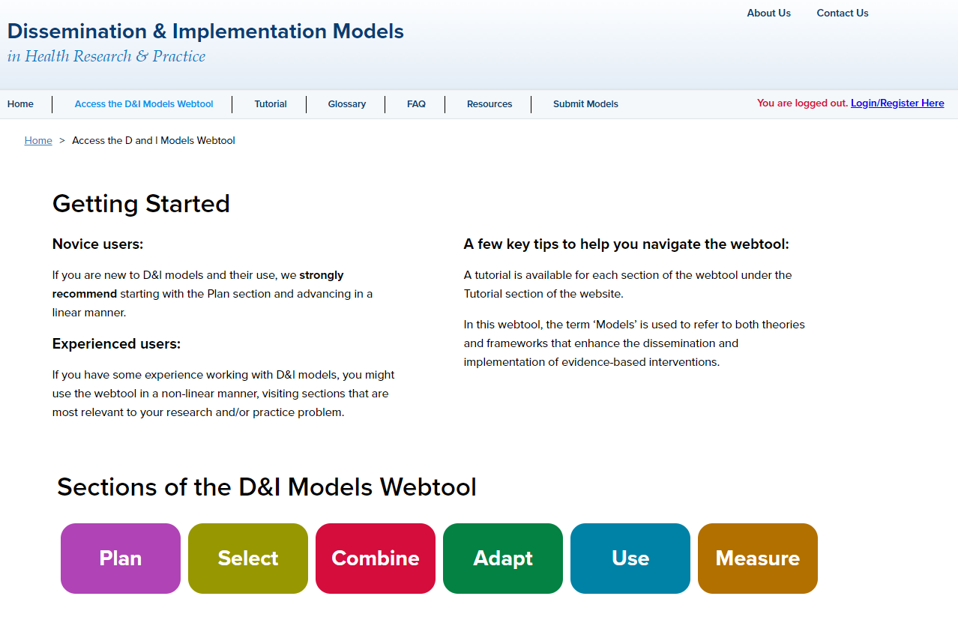
Mode
www.dissemination-implementation.org

Slide 40
Evaluation and Reporting in IS Research
Context and Representativeness (Expanded CONSORT)*
Implementation- including fidelity, adaptation, and variability
Costs- stakeholder perspective, replication costs, feasibility
Standards for Reporting Implementation Studies (StaRI)**
*Glasgow, R, et al. Amer J Prev Med, 2018; 55 (3), 422–430
**Pinnock H, et al. StaRI reporting standards. BMJ 2017;356:i6795

Slide 41
Equity Issues in Evidence-Based Research:
Evidence on What? (take home point)
External Validity/Pragmatic Criteria, Often Ignored
  Participant representativeness
  Setting and staff representativeness
  Multi-level context
  Adaptation/change in intervention and implementation strategies
  What outcomes for whom over what time period
  Reasons for participation and drop out
  Bottom line: What works for whom, under what conditions, for what outcomes, how much does it cost

Slide 42
Everything I Know (about Implementation Science)
Implementation Science is about:
Multi-level, contextual issues, and external validity
Relevant, pragmatic models, research methods and measures
Real world implementation and adaptation (T3 and T4)
Designing for dissemination, sustainability and equity
(Normal science (T1– T2) is necessary but not sufficient)

Slide 43
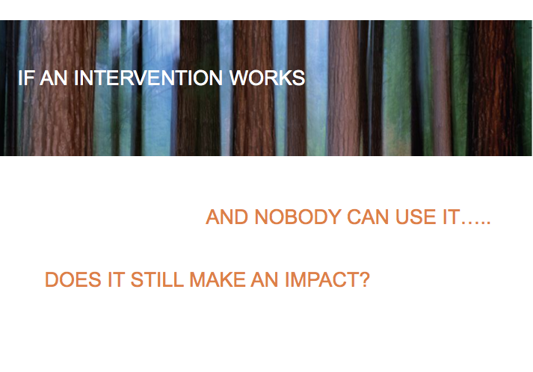
Notes:
USE FOR DAY 1 AS WELL!!!

Slide 44
RE-AIM Precision Medicine (PM)- or Precision Health Questions
What percent and types of patients are Reached (equity);
For whom among them is the PM intervention Effective, in improving what outcomes, with what unanticipated consequences (is health equity improved or decreased )?
In what percent and types of settings is this approach Adopted;
How consistently are different PM interventions Implemented at what cost to different parties;
    And how well are the intervention components and their effects Maintained at both setting and individual levels?
    Gaglio B, Glasgow RE. Evaluation approaches…In: Brownson R, Colditz G, Proctor E, (Eds). Dissemination and implementation research in health. New York: Oxford University Press; 2018. 317-334.

Slide 45
Key Science Questions- New and Old
Traditional science and evidence question (necessary but not sufficient): “What intervention produces the largest average effect in tightly controlled trials on the major (clinical) outcome?
Pragmatic D&I question (contextual):
  “What program/policy components are most effective for producing what outcomes for which populations/recipients when implemented by what type of persons using what strategies under what conditions, with how many resources and how/why do these results occur?”
Notes:
Should I include this here...or not...save for longer talk? Or good to point ow how DIS relates to T2- T3???
ABSOLUTELY YES – WE CAN EVEN MOVE IT UP AND HAVE ONE SLIDE ON T1-T4 AS WELL

Slide 46
Areas Ripe for Exploration
Sustainability of programs in a changing context
Scaling up practices across different health plans, systems, networks and nations: partnerships
De-Implementation: discontinuing wasteful and harmful practices
Adaptation/evolution of programs over time
Adaptive designs (implementation as an iterative, step-wise approach)
Integration of D&I and quality improvement
Chambers D & Norton W. (2016). The Adaptome, American Journal of Preventive Medicine, 51(4 Suppl 2), S124-31.

Slide 47
Current IS Funding Opportunities
PAR 19-274 (R01) CT optional https://grants.nih.gov/grants/guide/pa-files/PAR-19-274.html (17 institutes participate- not all in all 3 PARs)
PAR 19-275 (R21) CT optional https://grants.nih.gov/grants/guide/pa-files/PAR-19-275.html
PAR 19-276 (R03) clinical trial not al lowed https://grants.nih.gov/grants/guide/pa-files/PAR-19-276.html
PCORI: Pragmatic Trials; Dissemination projects
AHRQ: Embedded research studies; new RFAs
CDC: especially Prevention Research Centers
VA: QUERI program
Notes:
Add Fogarty?

Slide 48
Dissemination: What we know
Dissemination generally does not occur spontaneously and naturally;
Passive approaches to dissemination (diffusion) are usually ineffective;
Single-source prevention messages are generally less effective than comprehensive, multi-level approaches;
Stakeholder involvement in the research or evaluation process is likely to enhance dissemination;
Theory and frameworks for dissemination are beneficial; and
The process of dissemination needs to be tailored to various audiences
Brownson RC, et al. Designing for dissemination among public health researchers. Am J Public Health. 2013;103(9):1693-1699.

Slide 49
Adaptation, Fidelity and Tailoring Interest Group
Began January 2016 as part of the IRG
91 members currently ....YOU ARE INVITED TO JOIN
Representation from many VA QUERI research programs
Co-chaired by Borsika Rabin, MPH, PhD, PharmD and Russell Glasgow, PhD; Facilitated by Christine P. Kowalski, MPH
Meet monthly to discuss topics related to adaptation, tailoring and fidelity with attention to clinical application. Discussions include how to define interventions and implementation strategies, as well as how to describe and document adaptations.
For information or to join, contact: Christine.Kowalski@va.gov

Slide 50
Designing for Dissemination (D4D)
The process of ensuring that evidence- based interventions are developed in ways that match well with adopters’ needs, assets, and time frames
Might apply to any actionable finding, guideline, policy or packaging/deigning interventions (RTIPs, post hoc)
Timmings, C., Khan, S., Moore, J., Marquez, C., Pyka, K., & Straus, S. (2016). Ready, Set, Change!. BMC Medical Informatics and Decision Making, 16(24), 24.
Dearing JW, Smith DK, Larson RS, Estabrooks CA. (2013). Designing for diffusion of a biomedical intervention. Amer J of Prev Med 44: (1S2): 70-76.

