Slide 1
SSRI Workshop Series Workshop 1: Proposal Development SSRI Research Supports & Services
September 29, 2014

Slide 2
Workshop Goals and Agenda
Overview of the proposal development process
Overview of SSRI services and supports for proposal development. These include:
Financial support for proposal development and pilot studies
Consultation in research design, statistical analyses, budgeting and management
Research infrastructure

Slide 3
Proposal Development: Research Support Units at PSU
College Research Offices:
Information about funding agencies
College supports
Budget and management planning
Final proposal preparation & associated technical assistance
Proposal submission and grants management
College-based Research Centers
Programmatic research development in thematic areas
Interdisciplinary partnerships & resources
Information about funding opportunities within thematic areas
Social Science Research Institute
Cross-college partner and information clearinghouse (SSRI weekly announcements) – SSRI listserv
Pre-award support for proposal development
Research services available to Penn State social & behavioral scientists

Slide 4
Principles and resources apply to all kinds of funding sources
Federal Sources (examples)
National Institutes of Health (http://www.nih.gov)
National Science Foundation (http://www.nsf.gov)
U.S. Department of Agriculture (http://www.usda.gov)
U.S. Department of Education (http://www.ed.gov)
e.g., Institute of Education Sciences (http://www.ed.gov/about/offices/list/ies/index.html)
National Institute of Justice (http://www.ojp.usdoj.gov/nij)
Foundations—nonprofit, corporate, private, etc.
Penn State researchers have had success with, among others, Robert Wood Johnson Foundation, W. T. Grant Foundation, Ford Foundation, Pew Charitable Trusts, W. K. Kellogg Foundation, Spencer Foundation
Foundation Center’s online search (basic):
Available through the Penn State Office of Sponsored Programs website: http://fconline.foundationcenter.org

Slide 5
Phase One: Developing the Ideas and Research Team (6-12 months ahead of submission)
Tasks:
Refining research questions and specific aims
Identifying a funding mechanism
Conducting literature review
Accessing idea through consultation
Developing investigative team and roles
Mapping the proposal development timetable
Key Resources:
SSRI-CYFC – cross-college networking & seed funding for pilot work
College Research Offices – funding search & seed support
Research Centers – networking & idea development

Slide 6
Phase Two: Refining the Research Plan (3-9 months ahead of submission)
Tasks:
Consulting with funding program officers
Specifying the research plan & methodology
Conducting preliminary analyses or pilot studies
Recruiting community or cross-university partners (if needed)
Identifying research services needed for plan
Reviewing plan with department head and college research office
Key Resources:
SSRI – consultation for design & budget estimations for sampling and data collection, methodology, questions and plans, GIA, imaging
Research Centers, Library, & Consultation Centers

Slide 7
Phase Three: Refining and Submitting the Proposal (3 months ahead of submission)
Tasks:
Finalizing the work plan and budget
Internal review by colleagues or invited external consultants
Gathering and finalizing support documents (biosketches, letters of support from consultants and school/community partners, internal budget matches)
Format review to guarantee compliance with funder specifications
Key Resources:
College Research Offices – Proposal formatting, budget finalization, proposal submission
SSRI – Initial consultation on work plan and budget organization (if needed); seed funding to support reviews by invited consultants

Slide 8
Phase Four: Review, Revision, and Resubmission
Tasks:
Analyzing the reviews – discussions with colleagues
Consulting with the funding project officer
Responding to the reviews
Resubmitting
Key Resources:
Cycle back to any of the previously listed resources, as needed on the basis of reviews….

Slide 9
SSRI Research Infrastructure
Seed Funding
Facilitated Projects
Services and Shared Infrastructure

Slide 10
Seed Funding and Faculty Fellows
Level I: http://www.ssri.psu.edu/funding/level-1-funding
Level II: http://www.ssri.psu.edu/funding/level-2-funding
Facilitated
Faculty Fellows: http://www.ssri.psu.edu/funding/ssri-faculty-fellows-program
Cross-Institute Opportunities
OVPR Institutes, e.g. Marcellus Shale Development
Clinical Translational Science Institute (CTSI) mechanisms
K-12 Training program; T12 program
Translational Research Clusters

Slide 11
SSRI Research Services
Consult with our directors
Are these services right for your project?
Build proposal development costs into Level I and II proposals
Build research support services into the proposal for external funding
Use infrastructure supported by SSRI and other PSU Research Institutes

Slide 12
SSRI Grant Writing Workshops
Workshop #2: The Grant-Writing & Review Process at NIH . December 15, 2014, 8:30 a.m. – 11:30 a.m., The Living Center, 110 Henderson
Workshop #3: Introduction to Foundations and Grant Funding. January 23, 2015, 9:00 a.m. – 11:00 a.m., The Living Center, 110 Henderson
Workshop #4: The Grant-Writing & Review Process at NSF. March 24, 2015, 9:00 a.m. – 11:00 a.m., The Living Center, 110 Henderson

Slide 13
SSRI Research Units/Services
Clearinghouse for Military Family Readiness
Survey Research Center (SRC)
Social, Life & Engineering Sciences Imaging Center (SLEIC)
Geographic Information Analysis Core (GIA)
Methods Consultation
Research Data Center (RDC)
Data Management and Research Networking - REDCap

Slide 14
Clearinghouse for Military Family Readiness Daniel Perkins, Director Keith Aronson, Associate Director
New Penn State research center
Catalyze basic and translational research to improve the health & well-being of military personnel and families
Foster new research collaborations
Fund pilot studies through the SSRI
Develop collaborative relationships with military entities (e.g., DoD, Army, Navy, Air Force, USMC) to increase our understanding of, and access to military personnel and families.
Identify and team with funding agencies (e.g., NIH, DoD, service branches) interested in supporting military personnel and family research
WWW.MILITARYFAMILIES.PSU.EDU

Slide 15
Hot Topics in Military Family Research
Family functioning before, during, and after deployment
Family reintegration when service members experience traumatic stress
Evidence-Based program implementation & evaluation
Single parent families
Under-represented, non-traditional families
Treating PTSD outside of traditional VA system
Pediatric and adult obesity prevention

Slide 16
Awards to Date
Title Funder
Army Portfolio Capability NAVSEA
Navy Youth Sports and Fitness Kansas State University
Innovative Practices University of Minnesota
Learning Products University of Minnesota
Portfolio Capabilities Assessment NAVSEA
Navy Youth Sports and Fitness Kansas State University
Air Force FAP USDS
Severity Scales USDA
Clearinghouse USDA
Directory of Opportunities Kansas State
Implementation of OSN Survey USDA
Military Family Foundations NICHD
Navy Youth Sports and Fitness Kansas State
Navy Youth Sports and Fitness Kansas State
Air Force Family Advocacy USDA
DODEA USDA
Clearinghouse USDA
Clearinghouse USDA
Clearinghouse Purdue University
Marine Suicide Impact Navy Medical
Clearinghouse USDA
Clearinghouse USDA
Navy Youth Sports and Fitness Kansas State University
Clearinghouse Purdue
Clearinghouse USDA
AZ Reach University of Arizona

Slide 17
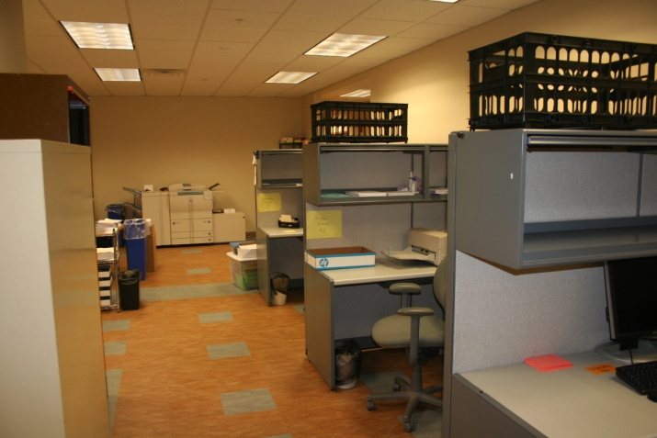
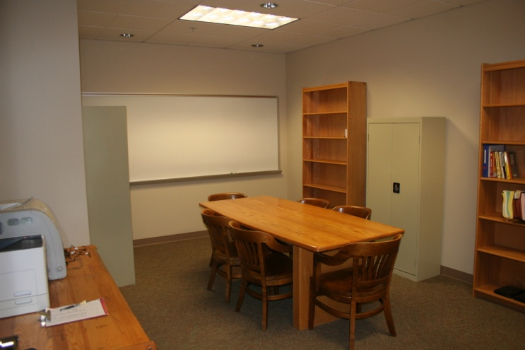
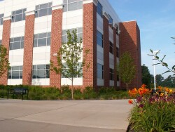
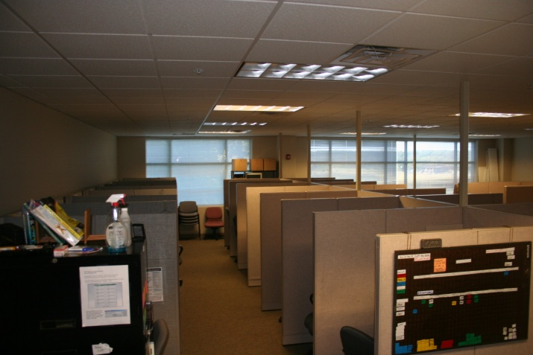
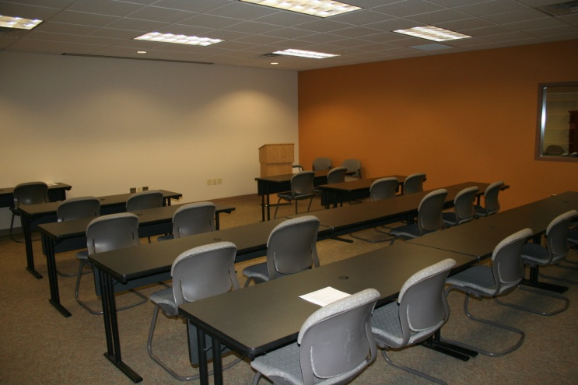
Survey Research Center
Kurt Johnson, Director www.survey.psu.edu

Slide 18
Survey Research Center www.survey.psu.edu
Mission
Survey Data Collection and Data Preparation
Pre-award help with grants and survey methods
Post-award services on fee-for-service basis
Survey Research Training (Certificate Program)
Focal Point for Research on Survey Methodology

Slide 19
Survey Research Center www.survey.psu.edu
Methods of Data Collection
Mail and self-administered (scanned/data entry)
Phone Surveys
Data Entry
Project Management
Face-to-face interviews
Surveys administered in schools
Web-based surveys
Technology based surveys (Smart Phone/Tablet)
EMA Data Collection (DREAM)
Focus group recruiting and facilitating
Daily Diary Studies
Collection of biological samples

Slide 20
Survey Research Center www.survey.psu.edu
Pre-award (no to minimal cost)
- Developing sampling designs
- Survey instrument ideas
- Help with study design decisions
- Prepare cost estimates for proposals related to SRC services
- Workshops, training

Slide 21
Survey Research Center www.survey.psu.edu
Post-award (Fee for Service)
Develop and produce samples
Instrument development and evaluation
Management of complex projects
Data collection and preparation
Database preparation and some analysis services

Slide 22
DREAM Initiative
Dynamic Real-time Ecological Ambulatory Methodologies
Real-time data collection techniques to assess ongoing behavior, experiences, and environmental aspects of humans in their natural settings
Aims to understand processes as they naturally unfold in time and context
Includes:
Ecological Momentary Assessment (EMA)
Experience Sampling
Daily Diaries
Ambulatory physiological assessment

Slide 23
DREAM Initiative
Basic DREAM Services
Development of survey programs to be administered on smartphones
Smartphones available for rental at discounted rate
Management of phones and discounted service (data) plans
Documentation and technical support
Additional Services
Researcher training
Compliance monitoring and follow-up
Additional phone set-up procedures, delivery, etc.
DREAM may be able to accommodate other study-specific needs upon request
Faculty with expertise in EMA methods are also available for collaboration on projects.

Slide 24
SRC & DREAM
Contact Information
SRC Contact information
http://www.survey.psu.edu/
Kurt Johnson, Ph.D., Director
E-Mail: kdj11@psu.edu
Phone: 867-1290
Location:
Survey Research Center
The 330 Building, Suite 105
Innovation Park
DREAM Contact information
http://www.survey.psu.edu/dream
Joshua Smyth, Ph.D., DREAM Academic Director
Dena Lang, Ph.D., DREAM Research Associate
E-Mail: dream@survey.psu.edu

Slide 25
Social, Life, & Engineering Sciences Imaging Center (SLEIC)
What can neuroimaging do for you?
www.imaging.psu.edu

Slide 26
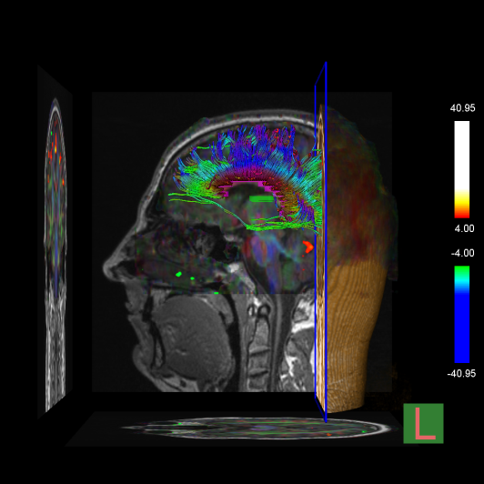
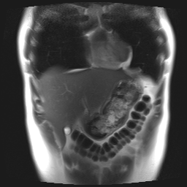
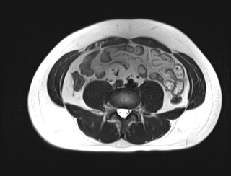
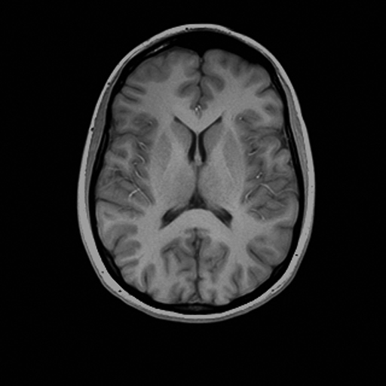
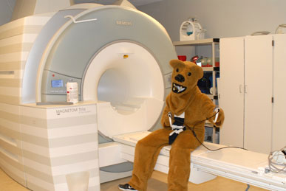
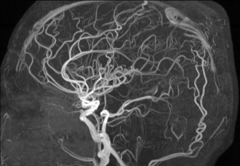
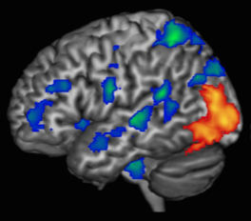
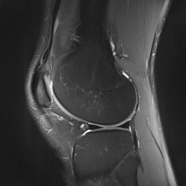
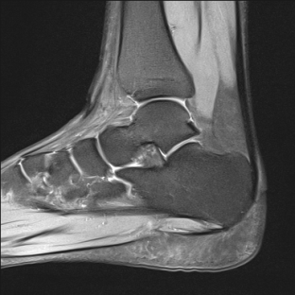
SLEIC 3T MRI Facility Michele Diaz, Director
Notes:
MRI is primarily a spatial technique.
Structural & functional capabilities
Focus on brain, but can image any body part.

Slide 27
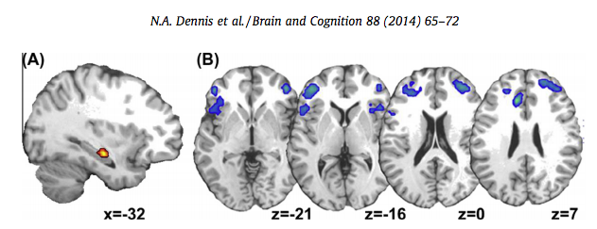
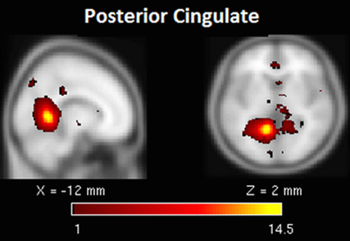
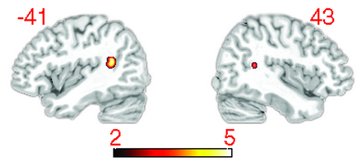
SLEIC 3T MRI Facility
True and False Memories
in younger adults,
Dennis et al., 2014
Relationship between white matter and word finding failures
in older adults, Stamatakis et al., 2011
Effects of TBI on functional brain networks, Hillary et al., 2014
Notes:
Dennis - “increased frontal activity that likely represents enhanced monitoring and evaluation compared to that needed for true memories and correct rejections. Results also indicated that true, and not false associative memories, are mediated by neural activity in the MTL, specifically the hippocampus”
Hillary the rich get richer: brain injury elicits hyperconnectivity in core subnetworks “To do so we examined 21 individuals with moderate and severe TBI at 3 and 6 months after resolution of posttraumatic amnesia and 15 age- and education-matched healthy adults using functional MRI and graph theoretical analyses. There were two central hypotheses in this study: 1) physical disruption results in increased functional connectivity, or hyperconnectivity, and 2) hyperconnectivity occurs in regions typically observed to be the most highly connected cortical hubs, or the “rich club”.”

Slide 28
Typical fMRI Setup

Slide 29
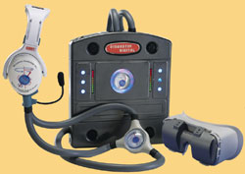
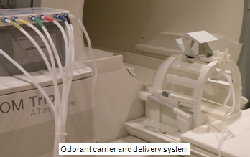
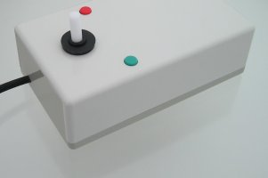
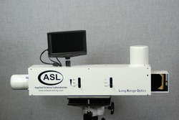
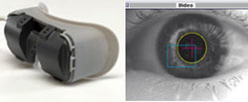
SLEIC’s fMRI Equipment
Stimulus Presentation Options:
Back-projection
Goggles with stereo display
Headphones
Olfactometer
Response options
Response grips
8 button response boxes
Joystick
Eye tracking
Physiological Recordings
ECG, Pulse Oxygen, breathing

Slide 30
SLEIC’s Mock Scanner
Simulates scanning experience
Training or habituation to scanning environment
Claustrophobia screening

Slide 31
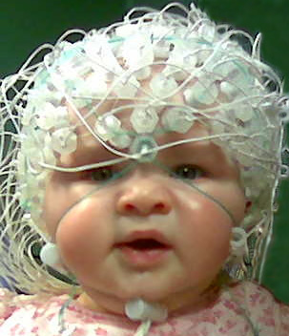
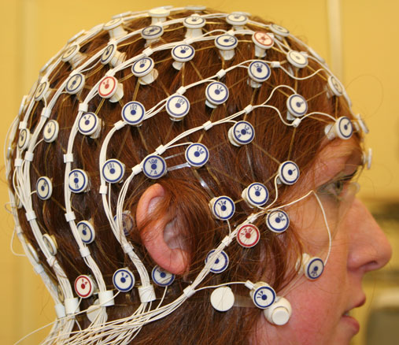
SLEIC Human Electrophysiology Facility (HEF)
EEG & ERP acquisition and analysis
Low & High density systems
Visual & auditory stimulus presentation
3D motion tracking and digitizing system
Ambulatory autonomic assessment system

Slide 32
Computing Resources
HEF Computer Lab (120 Chandlee)
Macs – Adobe Acrobat Professional, Net Station, Matlab
PCs – Adobe Acrobat Professional, Brain Vision Analyzer, E-Prime 2.0, Octave, Loreta and sLoreta
High Performance Computing (HPC) clusters
Matlab, EEGLab, SAS, R available
SPM, FSL, AFNI, Freesurfer, MRIcron, MRIcro, GIMME
CyberSTAR (Partnership with Institute for Cyberscience)

Slide 33
How to Get Started
Consultation with SLEIC staff
Facilities Use Application
Request for in-kind hours for pilot projects
Request for hours for funded projects
3T MRI rates: $520.64 / hr
HEF rates: $74.18 / hr
Obtain IRB Approval
Complete any needed training
3T MRI safety training
HEF net application
Pilot your experiment

Slide 34
How to Get Started
For more information:
Visit our website
http://www.imaging.psu.edu
Join our email mailing List
To subscribe, send a blank email to
L-SLEIC-INFO-SUBSCRIBE-REQUEST@lists.psu.edu
Contact SLEIC staff
L-SLEIC-HELP@lists.aset.psu.edu
(for any questions about the 3T MRI or HEF)
Michele Diaz mtd143@psu.edu
Thomas Neuberger tneu@engr.psu.edu (for High Field MRI Facility)

Slide 35
Geographic Information Analysis Core
Leif Jensen (lij1@psu.edu)
Faculty Director
Yosef Bodovski (yub107@psu.edu)
GIA Research Analyst

Slide 36
Background and Objectives
The GIA Core at the SSRI is one of the few spatial units in the US that are supported by NICHD.
Our objective is to provide expertise, services, and research collaborations to allow PRI/SSRI researchers to incorporate geographic information and/or spatial analytic techniques into their research, with an emphasis on interdisciplinary studies.

Slide 37
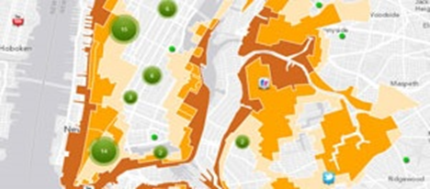
Goals
To be innovators in the collection, handling, and utilization of various forms of geospatial data
To develop new spatial analysis techniques and provide researchers sound advice and easy access to GIS analysts
To keep abreast of development in GIS and the availability of geospatial data (both domestic and international)

Slide 38
Why Care about “Space”
More research questions require analysis of complex patterns of both individual and environmental data.
Different types of data formats are now available and emerging.
Advances in GIS and analytic approaches offer new opportunities to enhance understanding of social phenomena.

Slide 39
GIA Core Service: Basic
Geospatial data management and archiving
Geocoding
Visualization/ Mapping
Nested and non-nested data construction

Slide 40
GIA Core Service: Intermediate
Exploratory spatial data analysis (ESDA).
Georeferencing/ digitizing
Geoprocessing
Spatial and network analysis

Slide 41
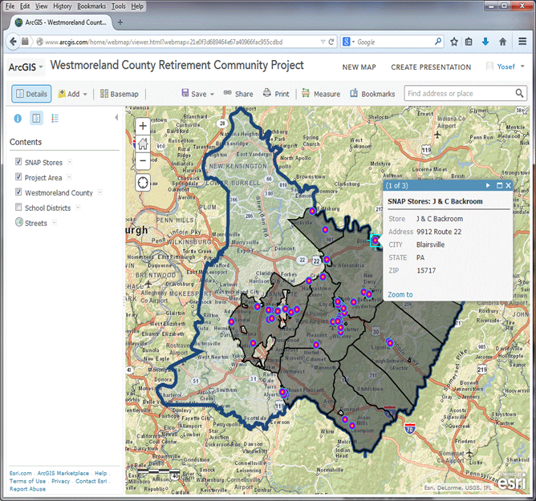
GIA Core Service: Advanced
Online mapping applications
Collecting data with GPS and wireless devices
GIS training

Slide 42
The Deliverables
Maps for publications, grant proposals, and presentations
Contextual data bases drawn from publicly available data sets or other geospatial data sources
Software programs, interactive mapping websites, spatial and network analysis

Slide 43
Who Can Use GIA Services?
To address the increasing demand, the PRI now provides GIA services to the population researchers in other NICHD-funded population centers. This includes:
PRI Research Associates at Penn State
(eligible for pilot hours seed grants)
Social Science Researchers at Penn State
(eligible for pilot hours seed grants)
NIH Population Center Associates Not at Penn State

Slide 44
Using GIA Core Services
The SSRI encourages researchers to support the GIS programmers efforts/time
For awarded projects, the PIs are expected to cover the GIA staff time with funding
For pre-award studies, SSRI provides two mechanisms to use GIA services:
internal pilot grants to support preliminary analysis or GIA activities (SSRI level I and II)
Internal pilot hours that are only focused on GIA tasks

Slide 45
Be spatially creative
Spatial perspectives are getting more and more attention, especially in the health and social sciences. The GIA Core has contributed to several funded projects.
If you are uncertain whether GIA can make your research special/spatial, the GIA Core staff are ready to discuss the potential with you.
The GIA Core may provide training on GIS and spatial analysis techniques according to your research needs.

Slide 46
Contact us
Leif Jensen: lij1@psu.edu
Yosef Bodovski: yub107@psu.edu
http://www.ssri.psu.edu/services/ geographic-information-analysis-core

Slide 47
QuantDev Consulting Services Eric Loken, Director
Who we are: Historically an HDFS team of methods faculty have provided consultation for faculty, staff and graduate students in research design, and measurement. This group is now known as QuantDev (short for Quantitative Developmental Systems) and is supported by HHD and SSRI.

Slide 48
Group members
Eric Loken, Director, Consultant
Michael J. Rovine, Consultant
Peter C.M. Molenaar, Consultant
Sy-Miin Chow, Consultant
Nilam Ram, Consultant
Tim Brick, Consultant
Zita Oravecz, Consultant
David Wagstaff, Consultant
To make an appointment with a consultant, contact Eric Loken
Phone: 814-865-7091 Email: loken@psu.edu

Slide 49
We like grants
Although our consulting activities will not be limited to grant-related activities, we consider providing support for grant applications and providing consultation for funded research to be among our most important responsibilities.

Slide 50
Services provided
Single session consultations related to specific questions
More intensive collaboration related developing or ongoing research projects
Questions related to statistical software
Information about the newest and most innovative methods
Specializing in single subject time series modeling including fMRI data analysis
General questions about statistics

Slide 51
Possible to arrange…
Workshops
Consultant training for graduate students
Software for some specialized analyses

Slide 52
Developing a relationship with a consultant
Beginning at the beginning
Discussing questions related to the design of the study
Discussing measures
Discussing ways to analyze the data
Including the consultant as a member of the research team

Slide 53
Consistency of the proposal
We help to make sure the following all agree
Specific aims
Research questions
Statistical analysis

Slide 54
Other concerns
Analyzing preliminary or pilot data
Determining power
Reviewing proposal as a methodologist

Slide 55
Once the grant is funded
Supervising data analysis
Assisting with the preparation of reports, presentation, and papers
Continuing methodological support

Slide 56
Costs
Our services are currently free
We encourage having a consultant included in grant applications as part of the research team

Slide 57
Sponsors
Department of Human Development and Family Studies
Social Science Research Institute

Slide 58
Pennsylvania State University Census Bureau Research Data Center (PSUCRDC)
RDC network - 18 locations (Michigan, Minnesota, Cornell, Texas A&M, Berkeley, Boston, Atlanta, Chicago, New York, Washington, Stanford...). Expanding approximately 2 per year.
Centers allow researchers to access restricted use data collected by the Census Bureau and National Center for Health Statistics (NCHS).
Secure computer lab in Paterno Library with hard-wired connection to Census servers in Maryland
Funded by President and VP for Research, SSRI, Pop Center, Dean of Library, Colleges of LA, Agriculture, HHD, Science, NSF

Slide 59
Economic Data
Economic Data from Census:
Industry Censuses (Manufactures, Retail Trade, Services, Transportation...)
Foreign Trade (Import and Export Transactions)
Specialized Surveys (Technology, Pollution Control, Energy Use, Business Owners, Capital Expenditures..)
Longitudinal Employer Household Dynamics (LEHD)
Economic Data from Bureau of Labor Statistics (coming soon)
National Longitudinal Surveys of Youth (NLSY)
Quarterly Census of Employment and Wages
Job Openings and Labor Turnover Survey (JOLTS)
Consumer Price Indexes

Slide 60
Demographic Data
American Community Survey (1996-present)
American Housing Survey (1984 – present)
Decennial Census (1970 – 2000)
Current Population Survey March Supplements (1967-2005)
Survey of Income and Program Participation (SIPP)
One advantage over public use data – detailed geography

Slide 61
Health Data
Agency for Healthcare Research and Quality (AHRQ):
Medical Expenditure Panel Survey –household and insurance components
National Center for Health Statistics (NCHS):
National Health Interview Surveys (linked with other data sources including Medicare Enrollment and Claims and SSA Retirement, Survivors and Disability Insurance)
Specialized surveys (Nursing Homes, Hospice Care, Health Insurance, Aging, Immunization)
National Health and Nutrition Examination Surveys (NHANES)
Vital Statistics

Slide 62
Application Process for Access
Census Bureau Data Sets (3-6 months) - must have a statement identifying benefits to the CB
Proposal reviewed by Center for Economic Studies
Proposals using economic data are reviewed by IRS
NCHS Data
Proposal is reviewed by NCHS (6-8 weeks)
After project approval, apply for Special Sworn Status
Requested data sets will be available in a computer directory and all data access is done from the PSUCRDC
All output must pass disclosure review before release

Slide 63
Further Information
Data resources and application instructions
Web page www.psurdc.psu.edu
RDC Administrator is Chris Galvan, chris.a.galvan@census.gov. Start with Chris
Questions about economic data
Mark Roberts, Professor of Economics, Director PSUCRDC mroberts@psu.edu
Questions about NCHS or demographic data
Jennifer Van Hook, Professor of Demography and Sociology, Director Population Research Institute, jxv21@psu.edu

Slide 64
Clinical & Translational Science Institute (CTSI)
Established in 2011 at Penn State
Website: http://ctsi.psu.edu
Subscribe to our listserv by sending blank email to: L-CTSINEWS-subscribe-request@lists.psu.edu (bi-weekly, announcements, events, funding opportunities)

Slide 65
CTSI Key Function Areas
PI & Director
Lawrence Sinoway, MD
Clinical Services Core
Biostatics, Epidemiology, Research Design
Pilot Studies
Regulatory Support/Ethics
Biomedical Informatics
Co-Directors:
Urs Leuenberger, MD Susan McHale, PhD
Community Engagement
Education
Translational Technologies
Novel Methodologies
Tracking/ Evaluation

Slide 66
CTSI Research Services
Pilot funding opportunities
Community-engaged research resources (consultation, Community Advisory Board)
Biostatistics/study design consultation (BERD)
Ethics consultation
Clinical research support
Informatics tools (REDCap, i2b2, Profiles)

Slide 67
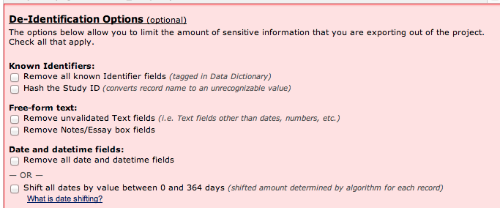
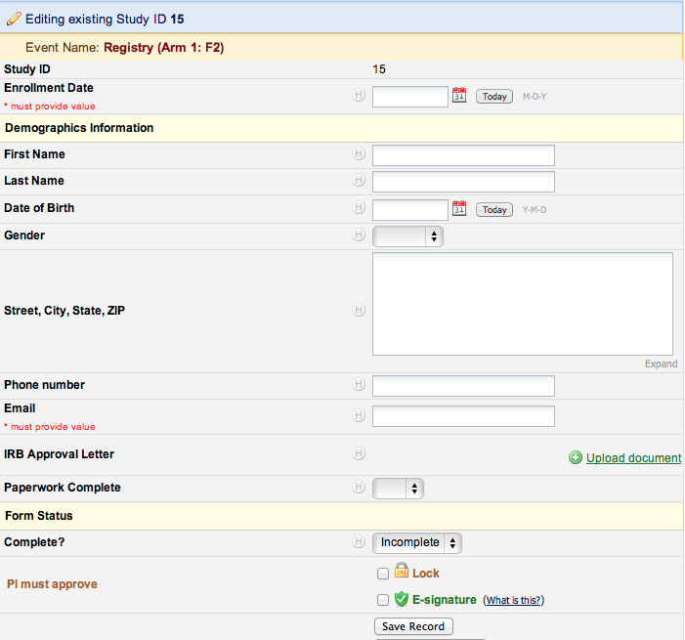
CTSI Resources: REDCap for Research Data Capture
Create, populate, clean & query a research database through web forms. No programming required.
Data obfuscation
E-signature & locking
Double-entry & quality control
Import data from csv
Reporting & export to stat packages
Surveys a/o data entry forms

Slide 68
Why Use REDCap?
Security & compliance
Web/Database programming skills not required
No hardware/software costs
Transferable skill -- used at over 1,000 research institutions worldwide
Support and training: redcap@hmc.psu.edu; CTSI website for upcoming training events

Slide 69
i2b2 (Informatics for Integrating Biology and the Bedside)
Informatics framework that leverages existing data for research cohort discovery
De-identified data from Hershey’s electronic medical record (updated weekly)
No IRB approval required to use i2b2
i2b2@hmc.psu.edu

Slide 70
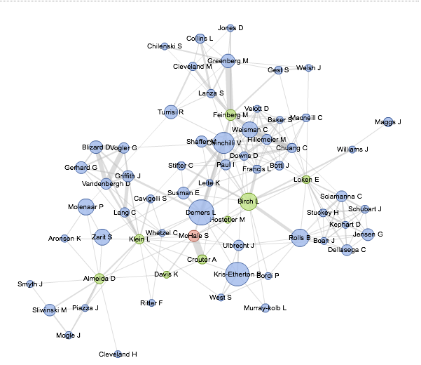
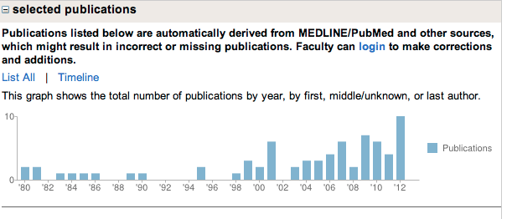
Profiles from CTSI: Networking & Expertise Mining for Research Collaboration

Slide 71
Clinical Research Center (CRC)
2 sites: University Park (Noll Lab) and Hershey Medical Center
Provides infrastructure, services for research involving human subjects
Operates on competitive fee-for-service basis
http://crc.psu.edu

Slide 72
CRC continued
Clinical Services/Equipment
RNs, NP, MD
Planning meetings
Med administration, blood samples, anthropometric measurements, metabolic testing, exercise stress testing, bone densitometry, etc.
Exam & procedure rooms, specimen processing facility, -80 freezer, metabolic cart, DXA, ultrasound machine, etc.

Slide 73
CRC continued
Nutrition Services/Equipment
Full time registered dietitian
Nutritional counseling, dietary analysis, metabolic kitchen, pre- and post-procedure meals
Fully-equipped metabolic kitchen/food storage area, dining area for 20 participants, private rooms for nutrition counseling sessions

Slide 74
CTSI Service Request Form
http://ctsi.psu.edu

